Slide 1
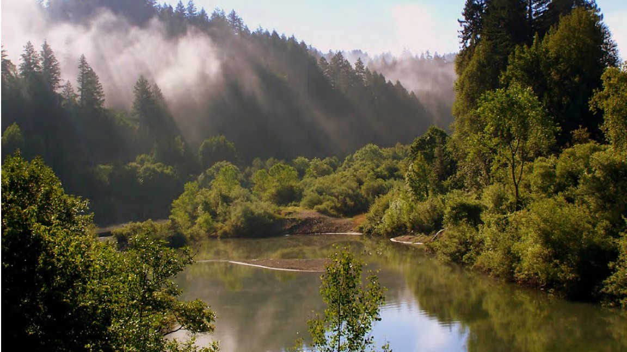



Russian River Watershed Resilience Pilot Update
Bay Area Flood Protection Agencies Association
Chris Delaney, Sonoma Water
Funding for this project has been provided in
full or in part from the Budget Act of 2022 and through an agreement with the State
September 30, 2026
Department of Wa ter Resources.

Slide 2
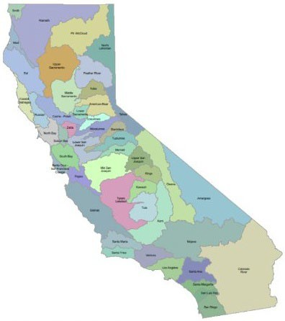
Watershed Resilience Program
Created Through the California Water Plan Update 2023
Evolves the IRWM Program with a focus on:
  Robust Climate Change Analysis
  Integrating across water resource sectors as the Watershed Scale
  Equity through collaboration, analysis, and investment

Slide 3
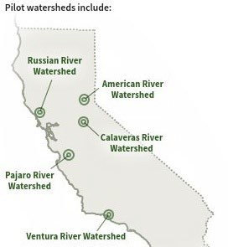
Watershed Resilience Program
Five pilots were selected to test approach
Leveraging resources developed by this team for DWR:
  Statewide Watershed Resilience Assessment
  Watershed Resilience Planning Framework and Toolkit
Future expansion to rest of watersheds in the state
DWR envisions that future funding for climate resiliency projects may be coordinated through watershed plans.

Slide 4

Intended Outcomes of Russian River Watershed Resilience Pilot
Collaboratively developed understanding of:
Groundwater Supply
Surface Water Supply
Flood Management
Impacts of Climate Change based on best available Science
Risks and Vulnerabilities to across water resource sectors
Ecosystems
Water Quality
Recreation
Most appropriate adaptation strategies to address Vulnerabilities
Hydropower
Community & Equity
Access to funding and implementation

Slide 5
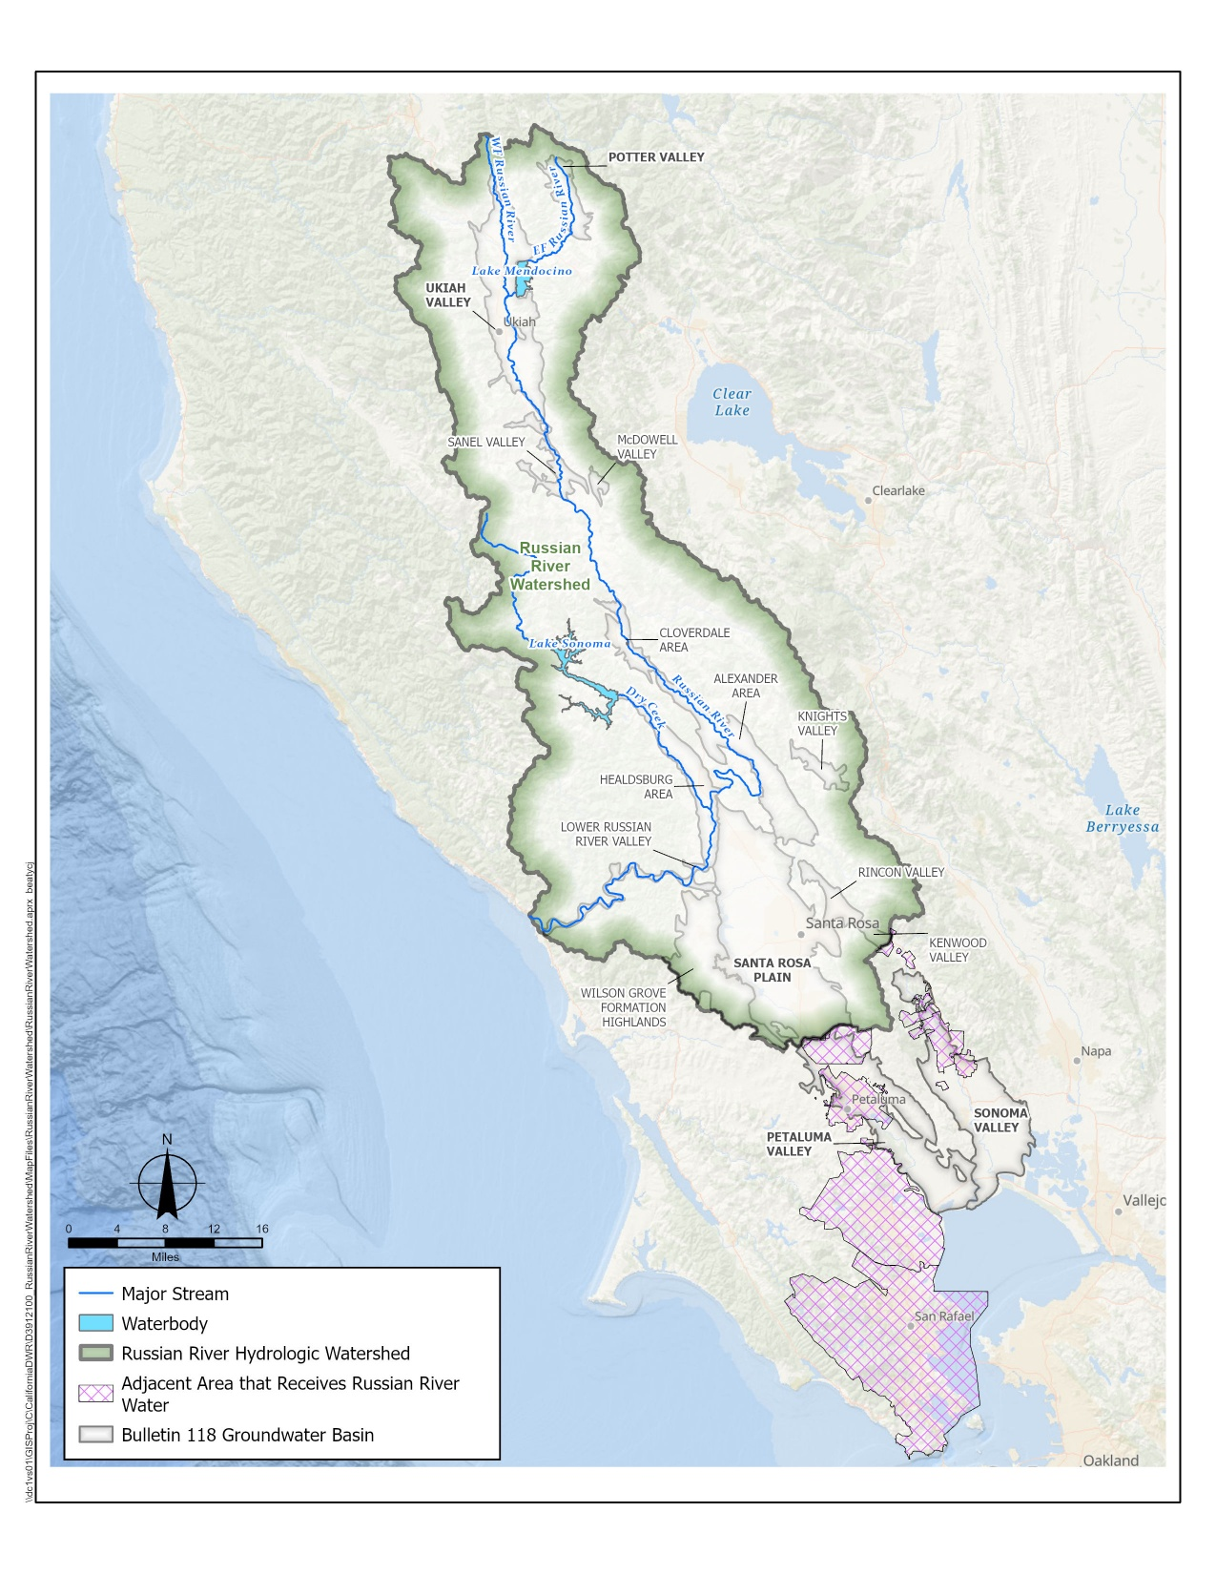
Pilot Project Area
Study Area Description
Boundary
  Russian River Hydrologic Watershed (HUC 8)
  Adjacent Areas that Receive Russian River water
Hydrological Features
  Lake Mendocino and Lake Sonoma
  Groundwater basins in RR Watershed
  Russian River Estuary
“Plus” Areas
  Adjacent areas that receive Russian River water
  Limited evaluation of water supply (surface water and groundwater) only
Notes:
Project area includes the hydrologic boundary of the Russian River.
Also includes “Plus” areas
Sonoma Waters service areas and the underlying aquifers
These areas are reliant on imports of Russian River water through Sonoma Water’s aqueduct
Therefore, it was important to include these regions for water supply and groundwater

Slide 6
Project Timeline and Milestones
Watershed Network Meetings: 6 Network Meetings 2 Technical Sessions Russian River Float 20+ Focused Outreach Meetings Tribal Outreach & Engagement Met w/ Tribal Groups One-on-on engragement | Meeting | WRP Stage | Goals | Preparatory Work/Meeting Material
 | #1 FEB 26 2025 | 1. Setting the Stage | Introduce plan; review goals and vision; review/confirm watershed boundary; initiate goals and vision | Project fact sheet GIS mapping of boundary Draft Vision
 | #2 MAY 6 2025 | 2. Explore Hazards 3. Assess Vulnerabilities and Risks | Review hazards; identify and describe historical events and impacts; describe future hazards; gap analysis Framing of vulnerability and risk assessment | Historical hazard summary Projections of change Gap analysis Draft vulnerability metrics
 | #3 SEPT 16 2025 | 3. Assess Vulnerabilities and risks | Review of vulnerability and risk assessment Integrate Network Members observations of vulnerabilities across water resource sectors | Draft vulnerability and risks assessment results
 | #4 DEC 10 2025 | 3. Assess Vulnerabilities and risks 4. Develop Adaptation strategies | Review refined vulnerability assessment Identify adaptation strategies for consideration | Vulnerability and risk assessment results Initial framing and identification of adaptation strategies
 | #5 FEB 24 2026 | 4. Adaptation Strategies | Review evaluation of adaptation strategies | Draft adaptation strategy list and evaluation
 | #6 MAR 24 2026 | 5. Implement & Monitor | Identify possible implementation paths; recommendations for plan | Draft implementation paths for strategies Draft recommendations for plan

Slide 7

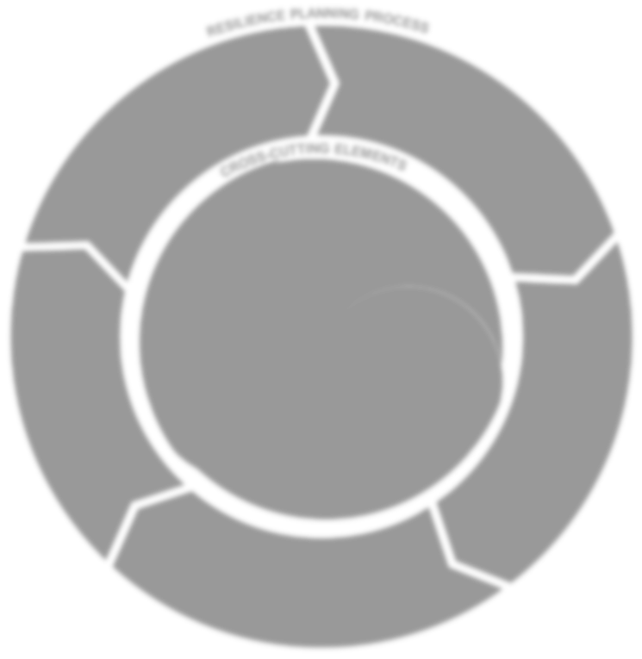
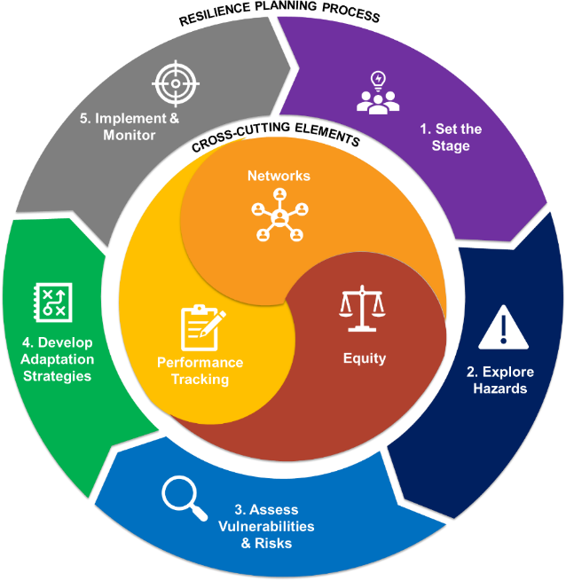



Major Steps in Watershed Resilience Pilot
Set the Stage
Explore Hazards
Assess Vulnerabilities & Risks
Develop Adaptation Strategies
we are here
5. Implement & Monitor

Slide 8
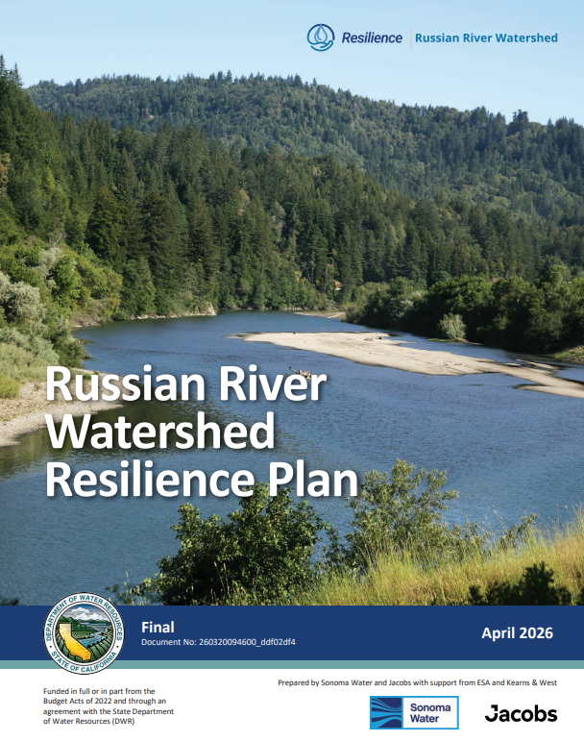
Final Watershed Resilience Plan
Completed April 2026
Identified 20 Key Climate Vulnerabilities
13 Climate Resilience Strategies
Implementation & Funding Strategies
Plan is available on the website: RussianRiverWatershedResilience.org

Slide 9
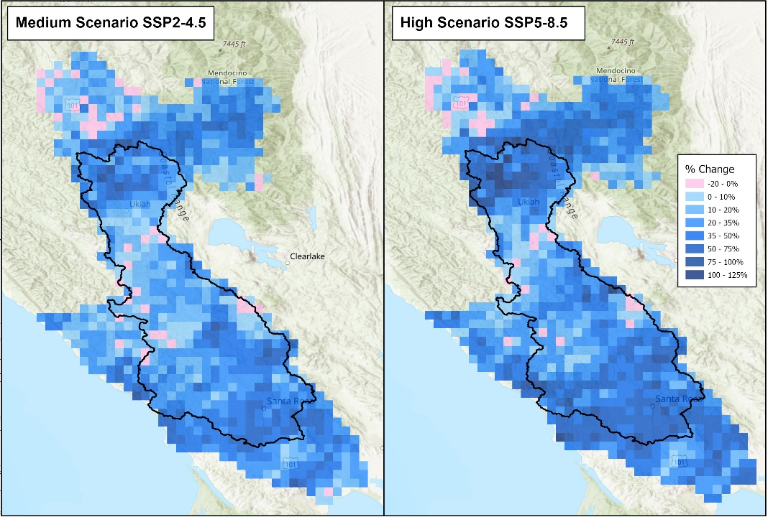
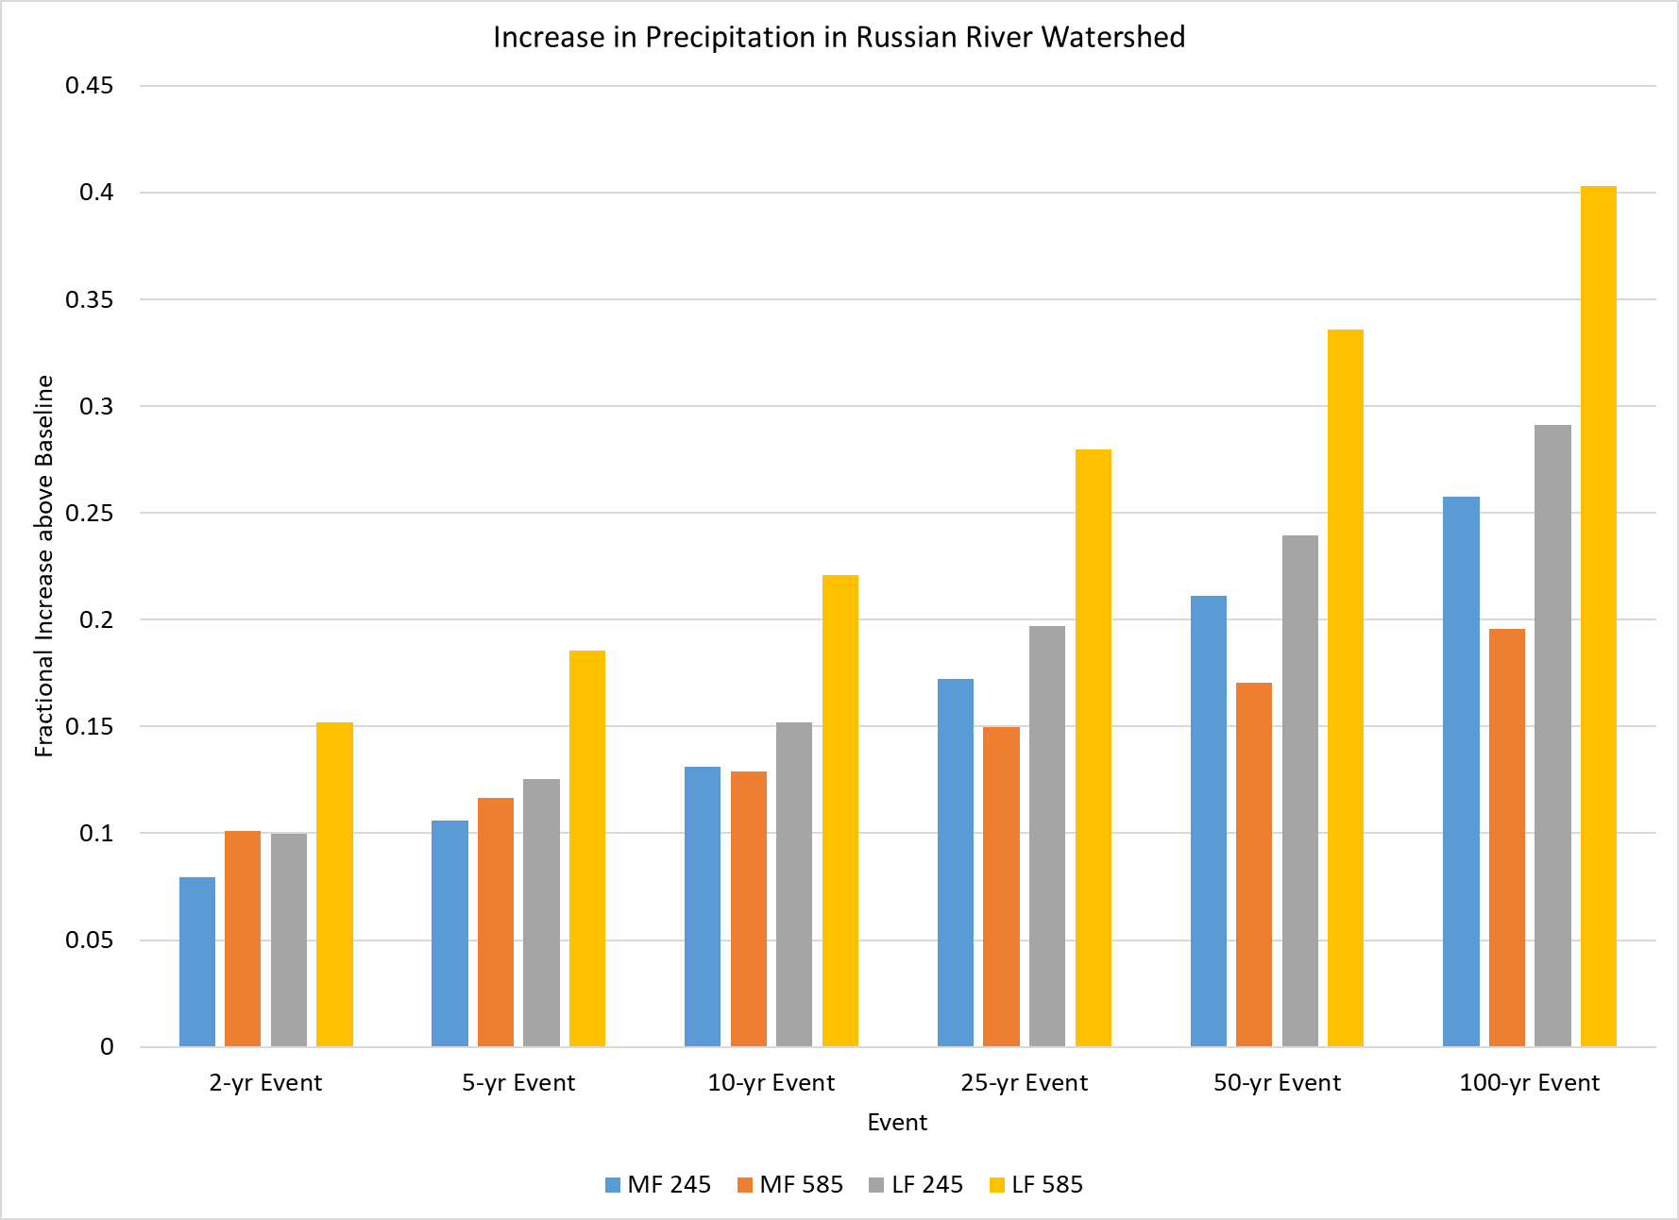
Flood Management: Extreme Precipitation is Increasing

Slide 10
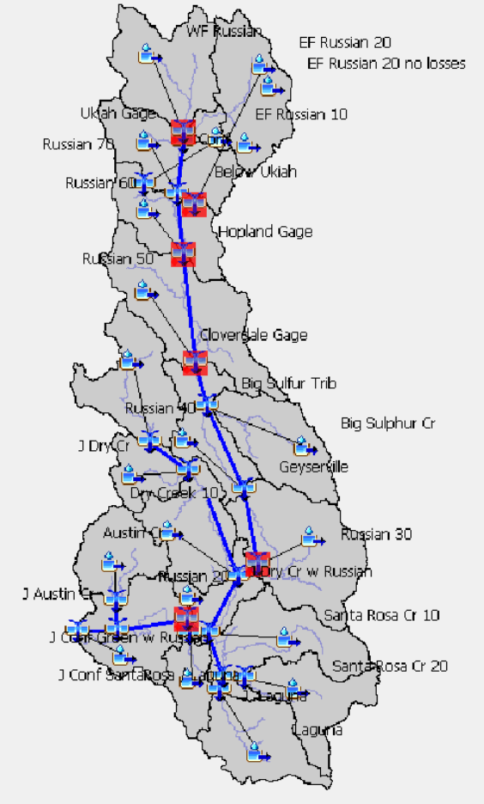
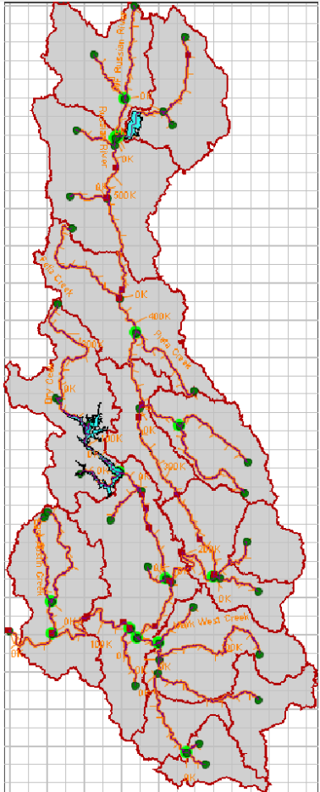
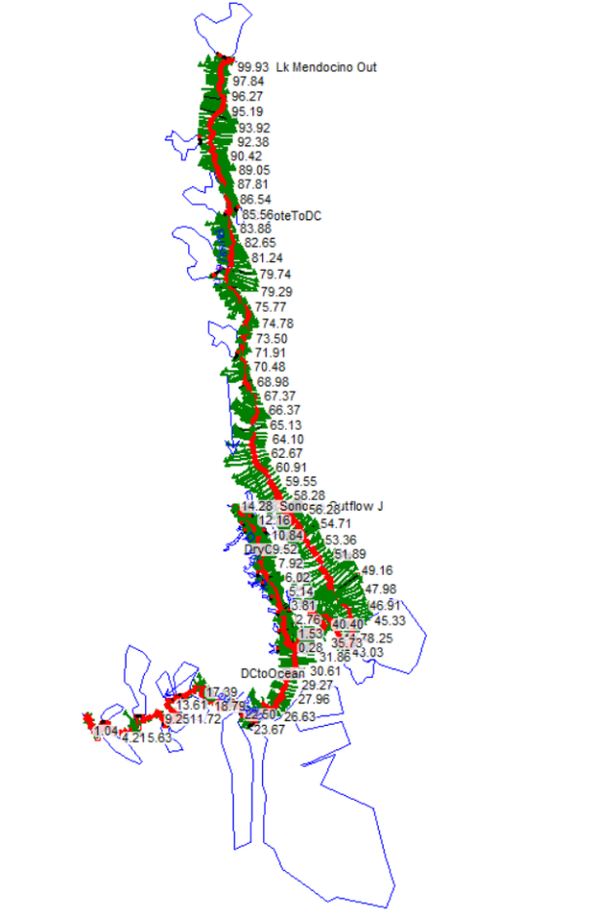
Flood Management: Analysis
HEC-HMS
HEC-ResSim
HEC-RAS
Hydrology Model(HEC-HMS) with Increased Rainfall
Reservoir Operations Model (HEC-ResSim) with Increased Inflows
Hydraulic model (HEC-RAS) with inputs from HMS and ResSim
Multiple Events (25, 50, 100-year floods and multiple future climate conditions

Slide 11
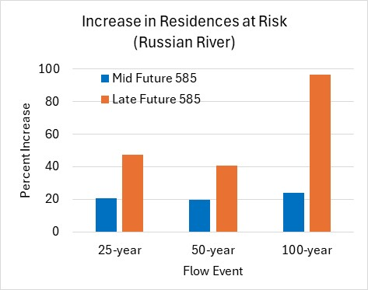
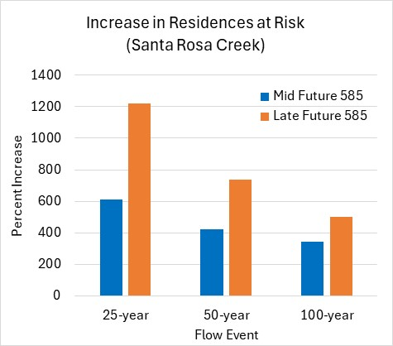
Flood Management: Findings
Six-fold increase in impacted residences in Santa Rosa Creek watershed for 100-year flow by late century
Larger impacts at smaller events in Santa Rosa
Doubling of impacted residences for 100-year flow by late century in Russian River watershed

Slide 12
Climate Adaptation Strategies
SW | GW | WQ | EC | FM | HP | RC
Climate Adaptation Strategy Water Resource Sectors
1. Increase Resilience to Changes in Upper River and Eel River Transfers
Received over 250 adaptation concepts from Network members
Across all water sectors and throughout the entire study area
Organized into 13 resilience strategies
Increase Water Supply Resilience to Drought
Increase Water Conservation and Water Use Efficiency
Expand Conjunctive Use of Surface Water and Groundwater
Improve Forecasts and Forecast-Based Operations
Reduce Flood Risk to Communities and Infrastructure
Manage Sustainable Headwaters and Support Wildfire Resilience
Promote Land Stewardship Measures to Restore Watershed Function
9. Restore Floodplains and Connectivity
Restore Hydrological Function, Habitat, and Thermal Refugia in Tributaries
Adapt Russian River Estuary to Future Conditions
Support Flexible and Adaptive Policy for Resilient Watershed Management
13. Enhance Tools, Monitoring, and Water Accounting Methods

Slide 13
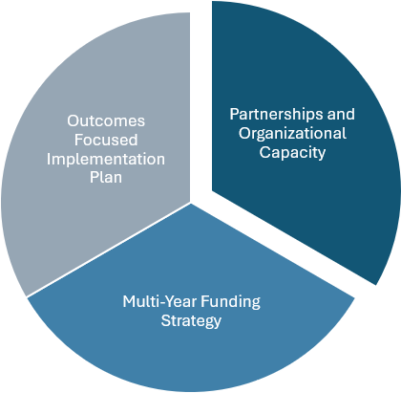
Work Planning for Next Phase
Build from Russian River Watershed Resilience Plan to focus on:
  Continue Watershed Network and Tribal Engagement
  Refine Resilience Strategies, Project Development, and Prioritization
  Support Implementation of Funding Strategy
Goal is to move from Plan to Implementation
Ensure the region is prepared and highly competitive for upcoming funding availability

Slide 14
Building a Broad Funding Stack
State Funding Sources
  Proposition 4 – Climate Bond
  State Revolving Funds
Federal Funding Sources
  Water Smart
  FEMA BRIC
Private Equity and Bonds
Philanthropy
Other Funding Mechanisms
  Local funding measures
  Public Private Partnerships
Federal Grants
Water Infrastructure Finance and Innovation Act (WIFIA) the State Revolving Fund (SRF)
Private Equity and Bonds
Philanthropy
State Grants

Slide 15
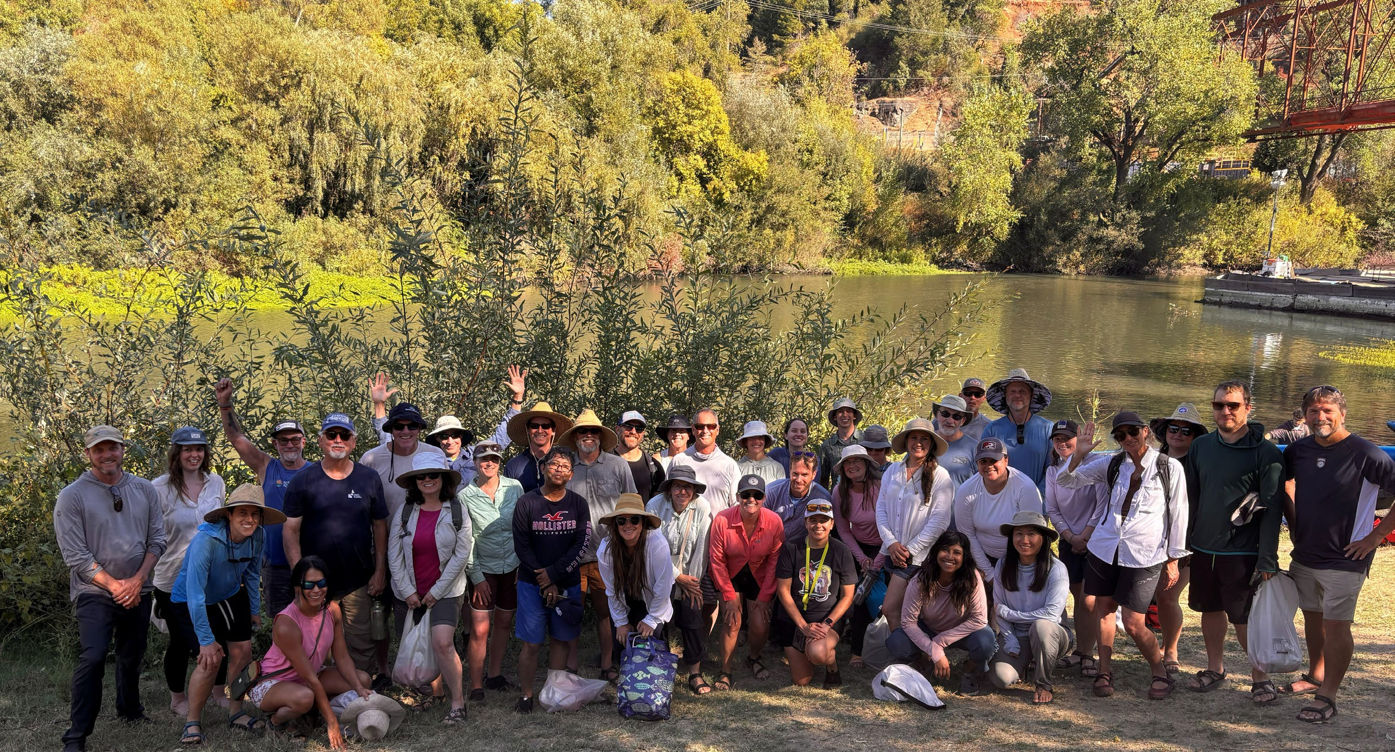
Closing – Thank You
Stephen Maples, Sonoma Water
stephen.maples@scwa.ca.gov
Chris Delaney, Sonoma Water
chris.delaney@scwa.ca.gov
Armin Munevar, Jacobs
armin.munevar@jacobs.com

