Slide 1
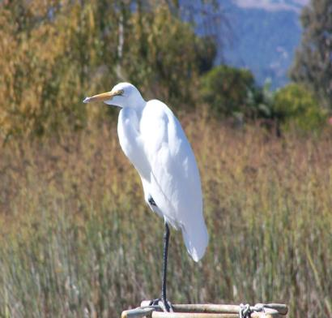
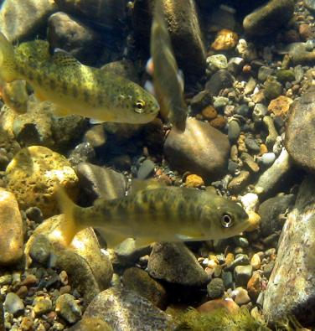
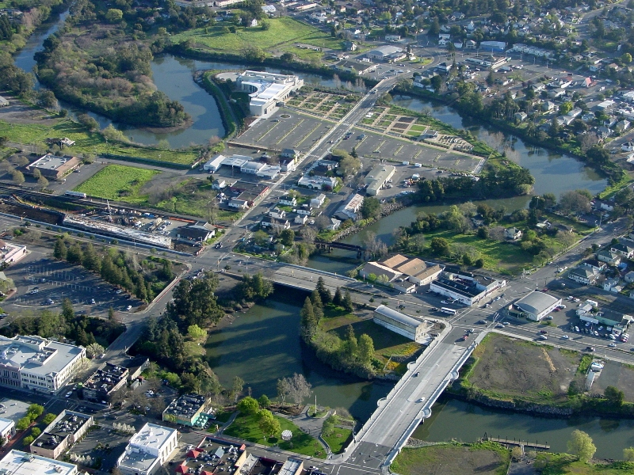
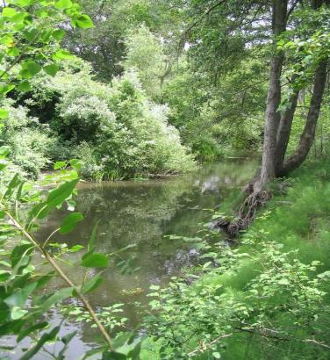
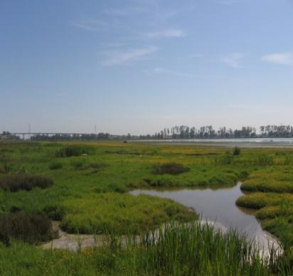
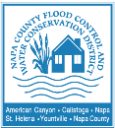
The Napa River Flood
Protection Project
A Living River Approach in an Era of Climate Change
Jeremy Sarrow, Napa County Flood Control & Water Conservation District
Notes:
Good morning BAFPAA members. Today I’d like to discuss the Napa River Flood Protection Project, its history and the innovative approach that was taken when designing the Project.

Slide 2
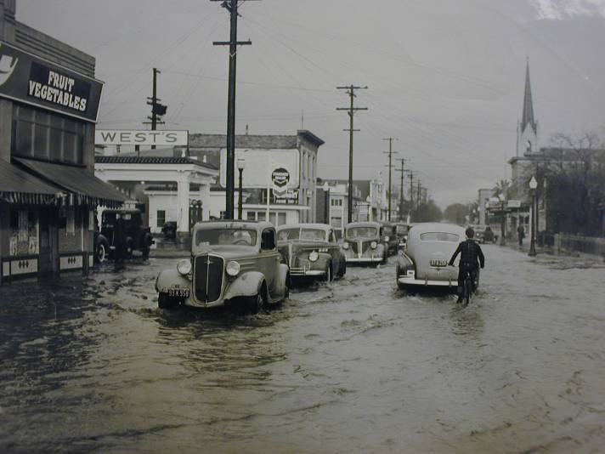
Need for the Project:
The City of Napa has a long well documented history of flooding
- 22 significant flood events since 1896 and as recent as 2005
Main Street, Napa 1940
Notes:
Napa is a river town and due to its location on the floodplain and banks of the Napa River, has flooded over 22 times in the past 130 years. The most recent significant flood was on New Years Eve in 2005. Here’s a view of main street in 1940 during a major flood.

Slide 3
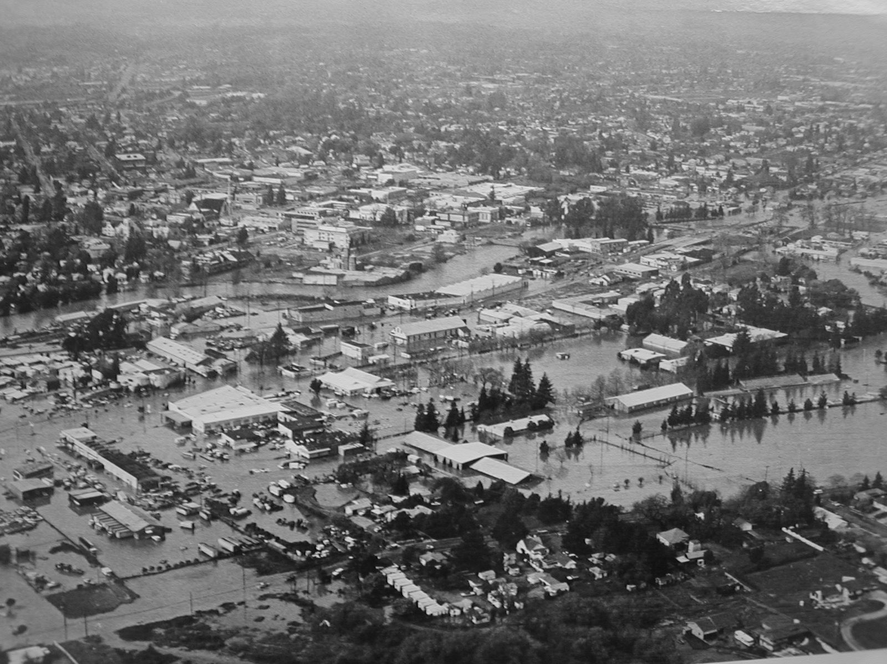
Background
1965 Congress authorizes a flood protection project for the City of Napa, Army Corps proposes typical flood design that involves deepening and straightening the river channel, rip-rapping banks and constructing a network of flood walls and levees
Project goes to voters in 1976 and 1977 and is rejected by the community, project remains in limbo until the 1986 flood which destroyed over 250 homes and damaged another 2,500.
Damages estimated at $100 million, galvanizing the County and City to petition the Army Corps of Engineers to reactivate the Napa River Flood Control Project – the 1995 design was similar to the original design and the community organizes to reenvision the project.
1986 Flood
Notes:
As a response to ongoing flooding congress authorized a flood protection project for the City of Napa in the Flood Control Act of 1965. So, in 1976 the Army Corps of Engineers designed a classic flood control project that widened and deepened the River, hardened the banks and isolated the City from the River with flood walls and levees. Funding for federal flood protection projects requires a "local share" which typically involves some form of taxpayer measure. So the Project was taken to the voters for funding and approval and promptly rejected for financial, environmental and aesthetic reasons and as a result, there was no local match, and the project did not move forward.
The project remained in limbo until the flood of 1986. As shown in this photo, the 1986-flood inundated most of the town and was the largest recorded to date. It destroyed 250 homes and damaged another 2500. The monetary damages were estimated at $100 million. In response to this flood, Napa County and the City of Napa petitioned the Army of Corps Engineers to reactivate the Napa Flood Control Project.
The subsequent project plan released by the Army Corps in 1995 was very similar to the original plan that was previously vetoed and because of the continuing issues with the Army Corps’ plan, the project was in jeopardy of being vetoed again.

Slide 4
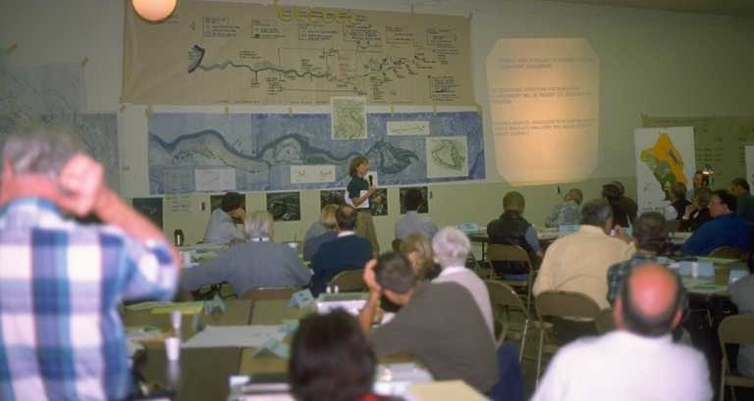
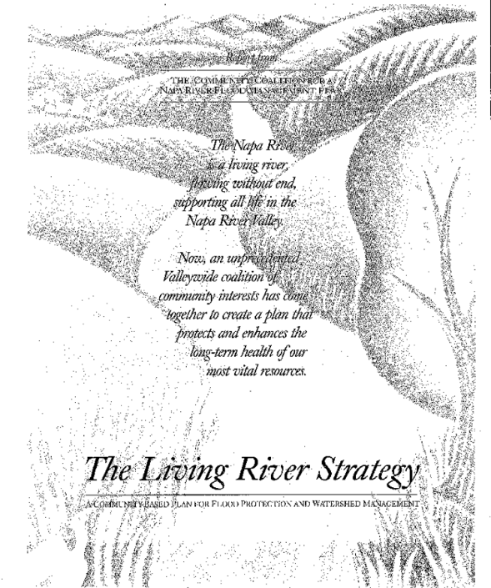
Formation of a Community Coalition
27 local stakeholder groups and 24 agencies tasked with developing a project that locals would be willing to support and pay for. The result of this planning process was the “Living River Strategy” which created geomorphic, water quality and habitat guidelines for the Project including:
  Creating a natural channel connected to floodplains and wetlands;
  Cleaning up contaminated sites;
  Raising and replacing bridges;
  Incorporating recreational features.
The result is a Project that not only provides100-year flood protection but also includes restoring over 1,200 acres of floodplain, riparian and wetland habitat and creating recreational spaces and opportunities in the heart of downtown Napa
Notes:
Enter the community coalition.
To the credit of the citizens of Napa County, they realized that the only way to move the project forward was to come up with an alternative process to develop the design. They formed a Community Coalition consisting of 27 local stakeholder groups and 24 agencies that were tasked with developing a project that the locals would be willing to pay for.
The outcome of the community coalitions planning process was a multi-benefit approach referred to as the Living River Strategy. The guiding principle for the strategy included:
Creating a natural channel connected to floodplains and wetlands;
Cleaning up contaminated sites;
Raising and replacing bridges;
Incorporating recreational features.

Slide 5
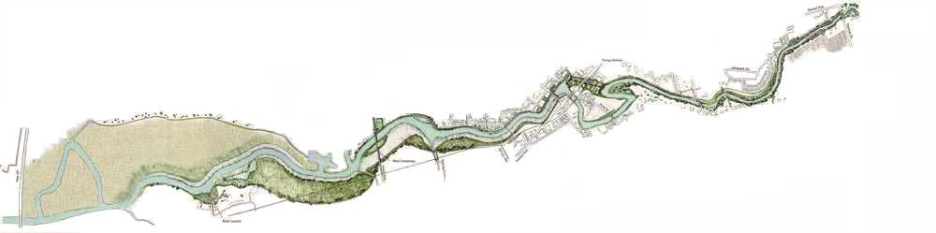
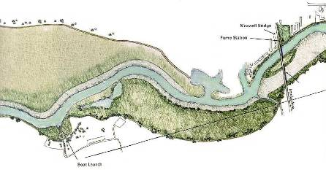
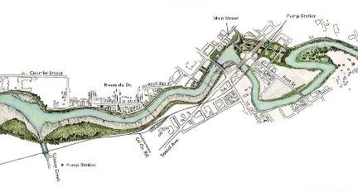
Napa River Flood Protection Project
Downtown “Urban Reach”
including Napa Creek
South Wetlands Area
Toxics Cleanup
Oxbow and Bypass
Marsh and Floodplain Terraces
Notes:
The project spans approximately 6.5 miles of the Napa River starting at the northern end of town and extending through the urban downtown reach of the City, ending in an area of mostly open space, agriculture and wetlands.
I also want to note that the river is freshwater upstream of the City, but estuarine/tidal throughout the flood project reach.

Slide 6
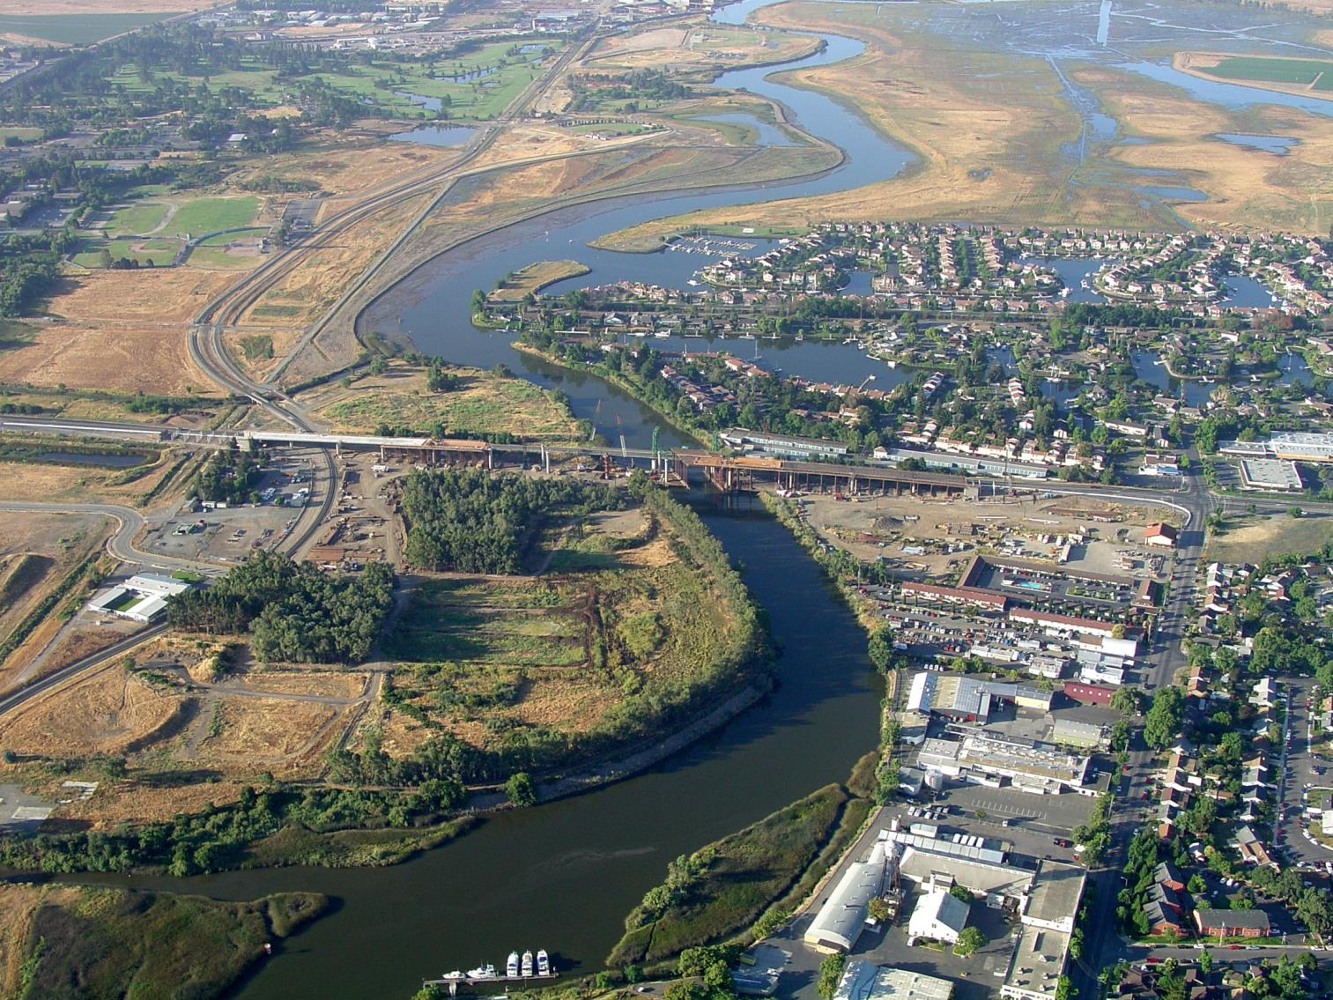
Creation of marsh and
floodplain terraces
Restoration of historic
marsh and wetland habitat
Replaced 9 bridges
Remediation Area
2005
Notes:
Project features:
Starting from the downstream reach on the project and moving upstream this photo illustrates several of the elements that were incorporated into the project including:
Creating a natural channel connected to floodplains and adjacent wetlands;
Cleaning up contaminated sites;
Replacing bridges with new ones that are both higher and longer

Slide 7
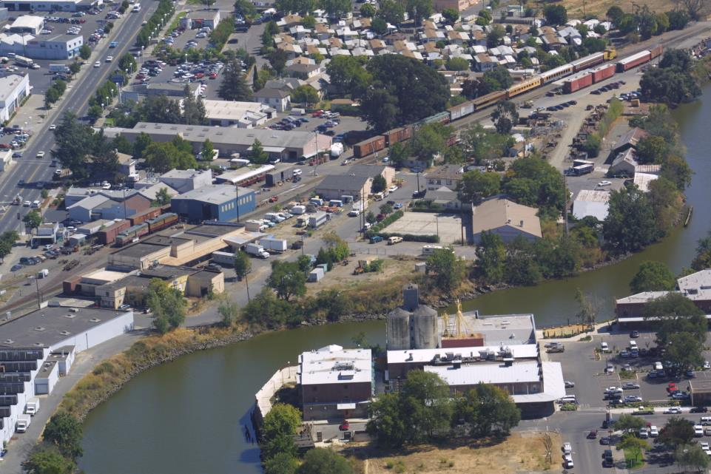
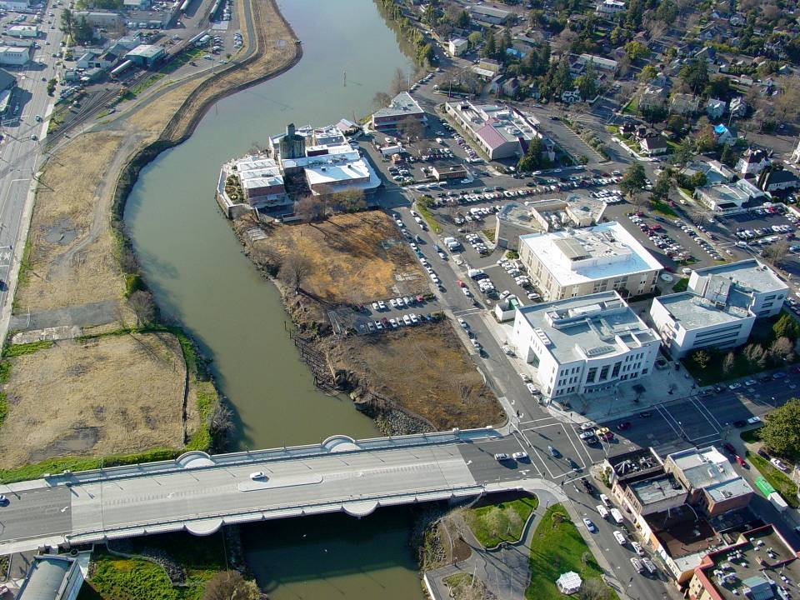
C2 East Terrace - Before
C2 East Terrace - After
The creation of marsh and
floodplain terraces included
the removal of industrial infrastructure and remediation of
contaminated soils; creating wildlife habitat and increasing hydraulic capacity
Notes:
Additional examples of infrastructure removal, floodplain expansion, clean-up of contaminated soils and habitat creation.

Slide 8
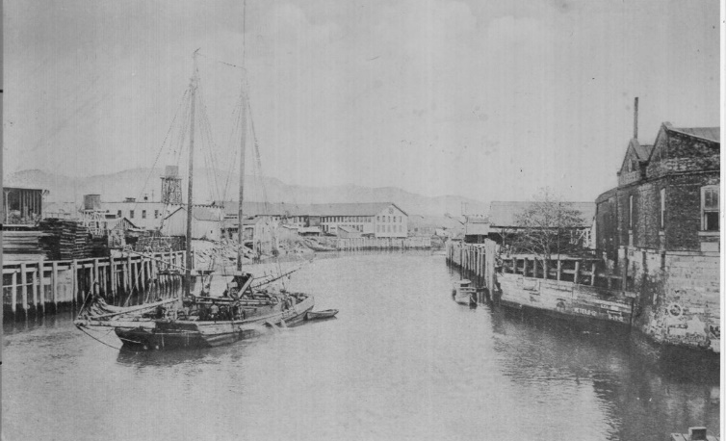
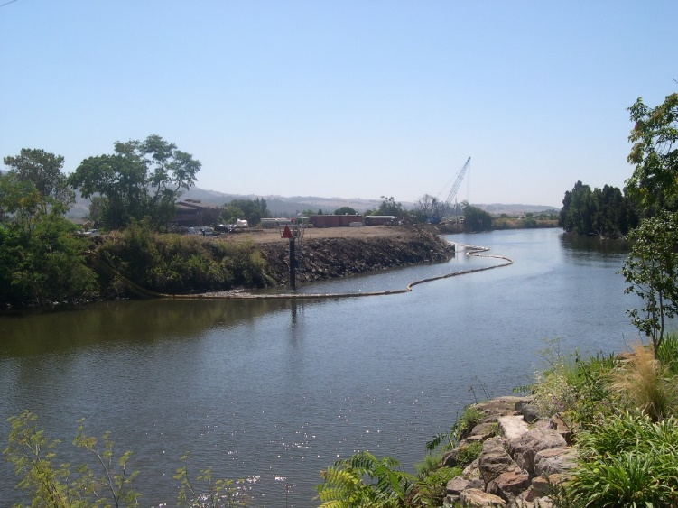
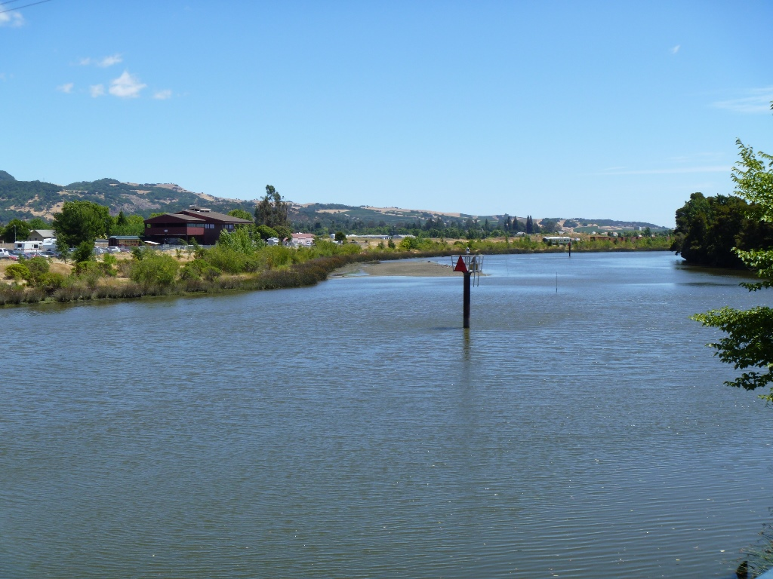
1800’s
1990’s
Present
Notes:
Additional examples of floodplain expansion and a reminder that the river is considered a “navigable” waterway by the Corps

Slide 9
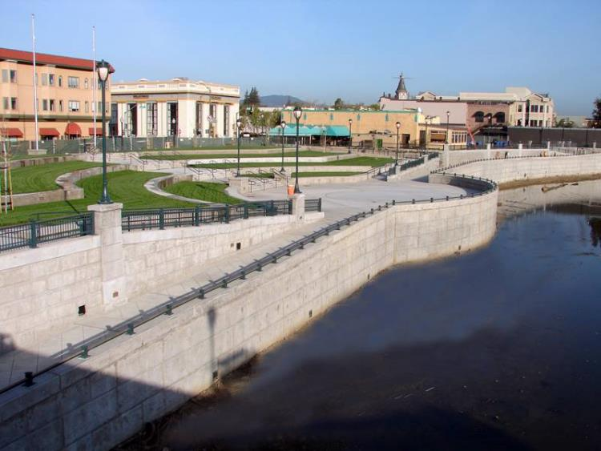
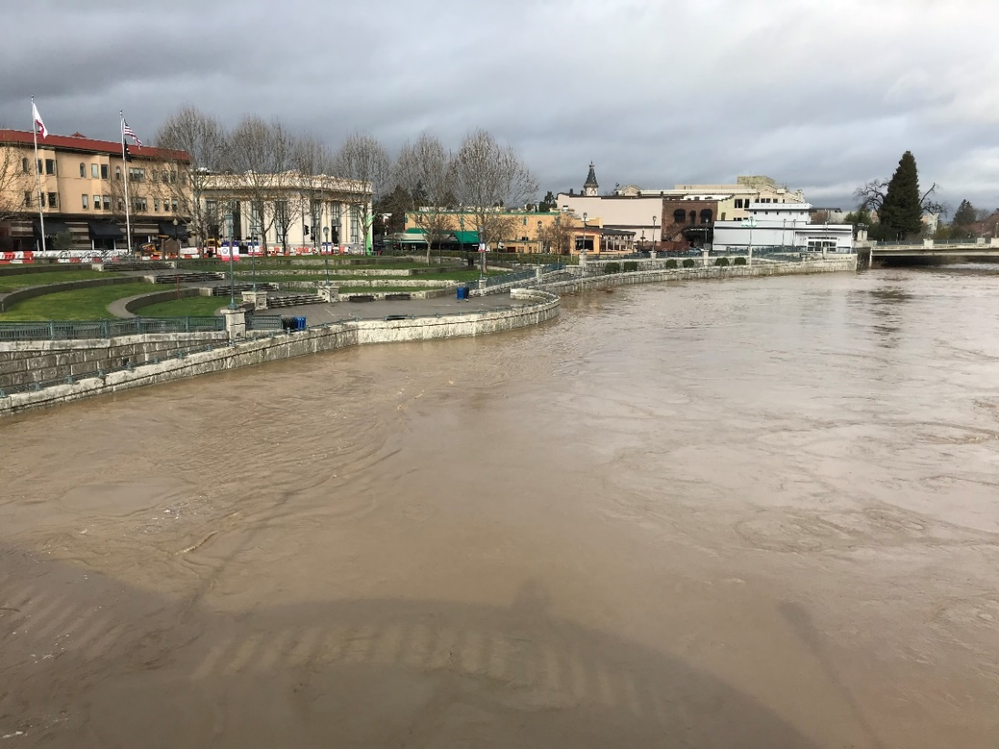
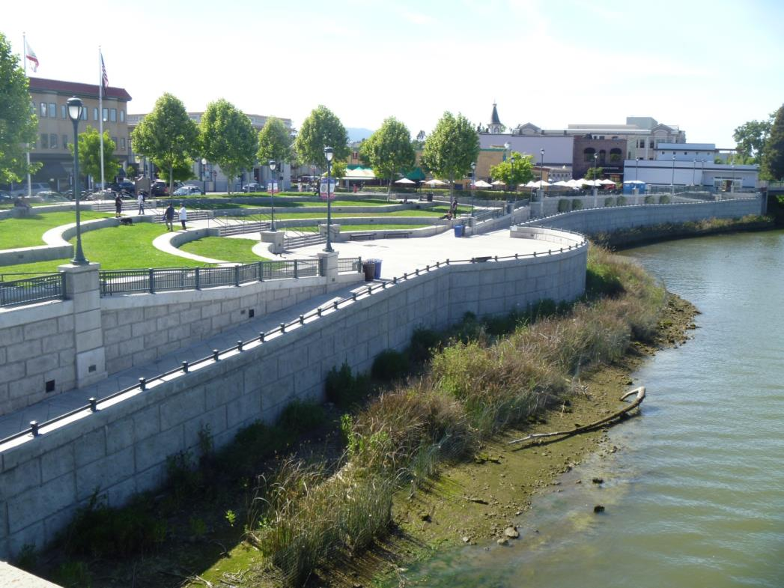
Veterans Park Floodwall
Veterans Park Floodwall
In addition to providing flood protection, project included creation and expansion of recreational areas
Created marsh plain terraces below flood walls in urban reach of Project
Notes:
So, what did the project mean for Downtown Napa? Redevelopment Agency officials understood that it was time to seize this opportunity to guide the design of the public improvements within the “Downtown Reach” of the Flood Protection Project considering not only flood protection but recreational features

Slide 10
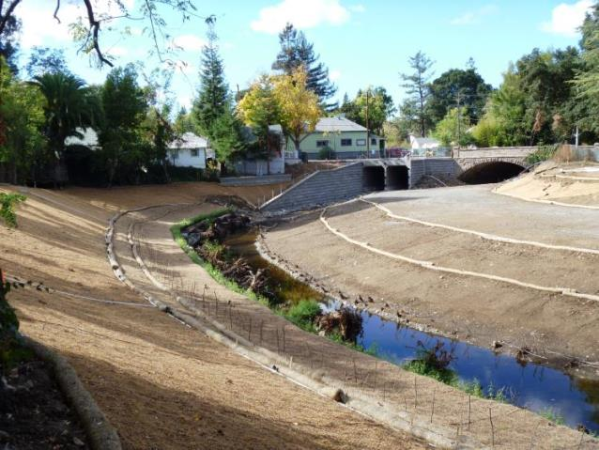
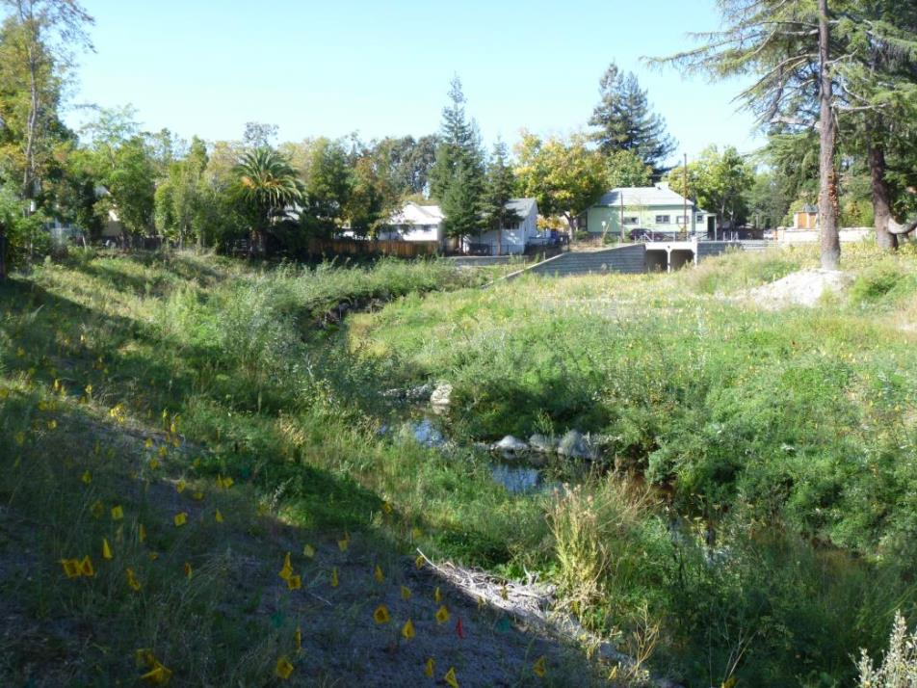
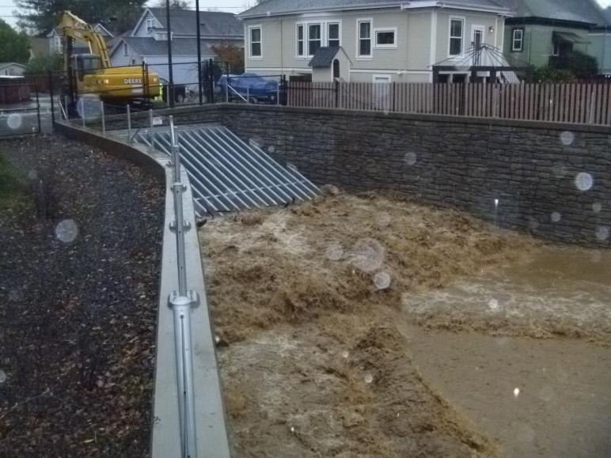
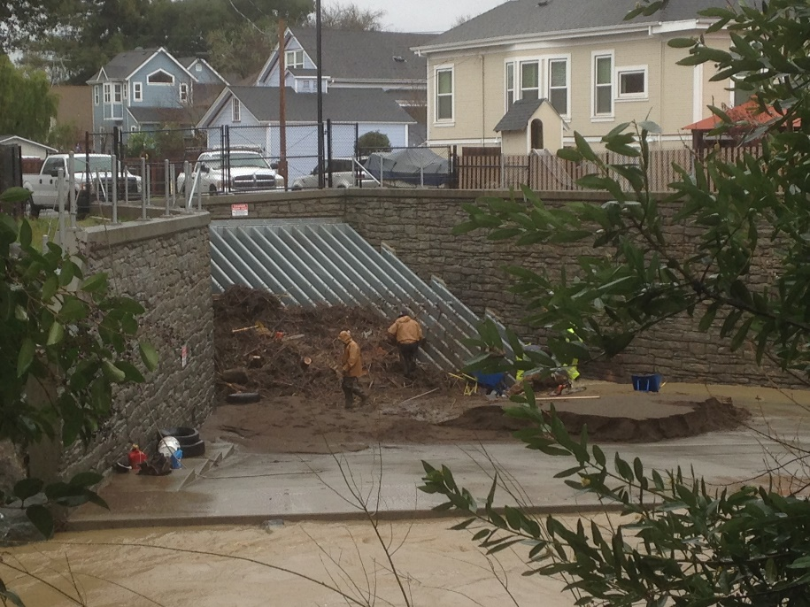
Napa Creek Bypass culverts
-Channel widened, double bypass culverts installed to increased conveyance
-Stream bank slopes laid back, instream habitat structures installed
Napa Creek - 2012
Napa Creek - 2013
Notes:
Napa Creek reach of the project
Pre-project Napa Creek was highly constrained and cut off from its floodplain and have over steepened eroding banks. project elements included widening the channel and creating in-set floodplain benches, biotechnical bank stabilization and instream habitat features, and installation of dual bypass culverts to effectively double the conveyance of the channel

Slide 11
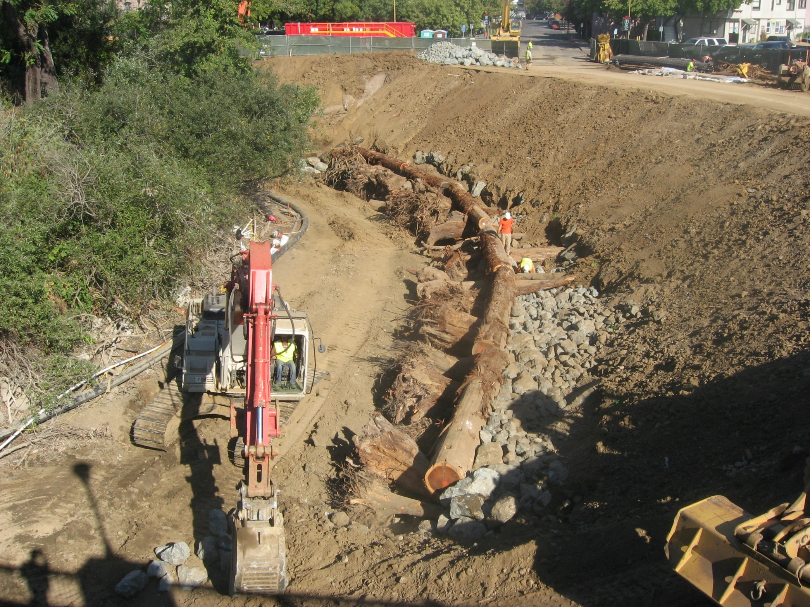
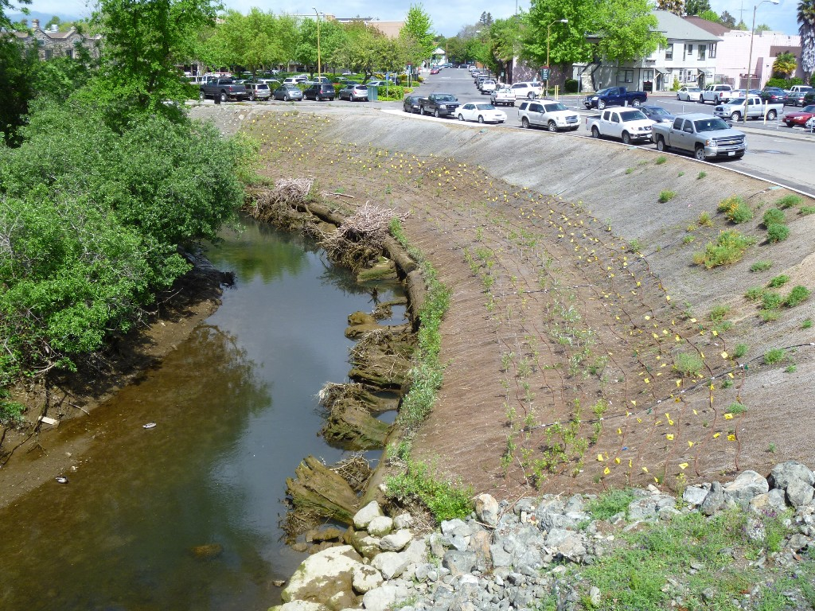
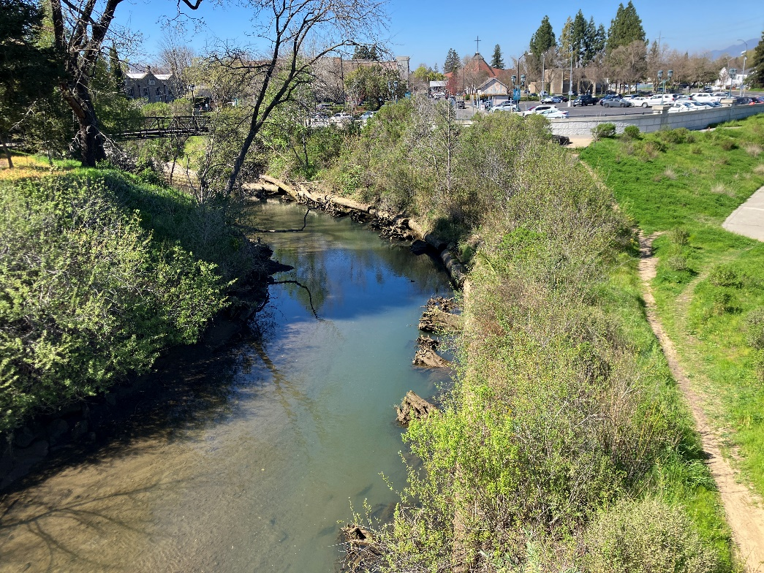
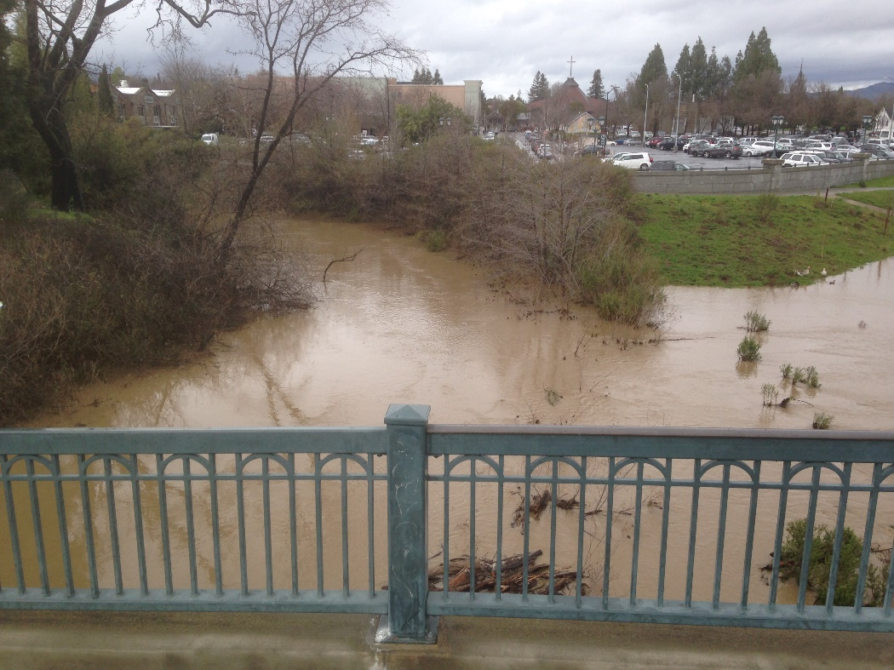
Napa Creek Restoration and Flood Protection Improvements
2011
Present
2019

Slide 12
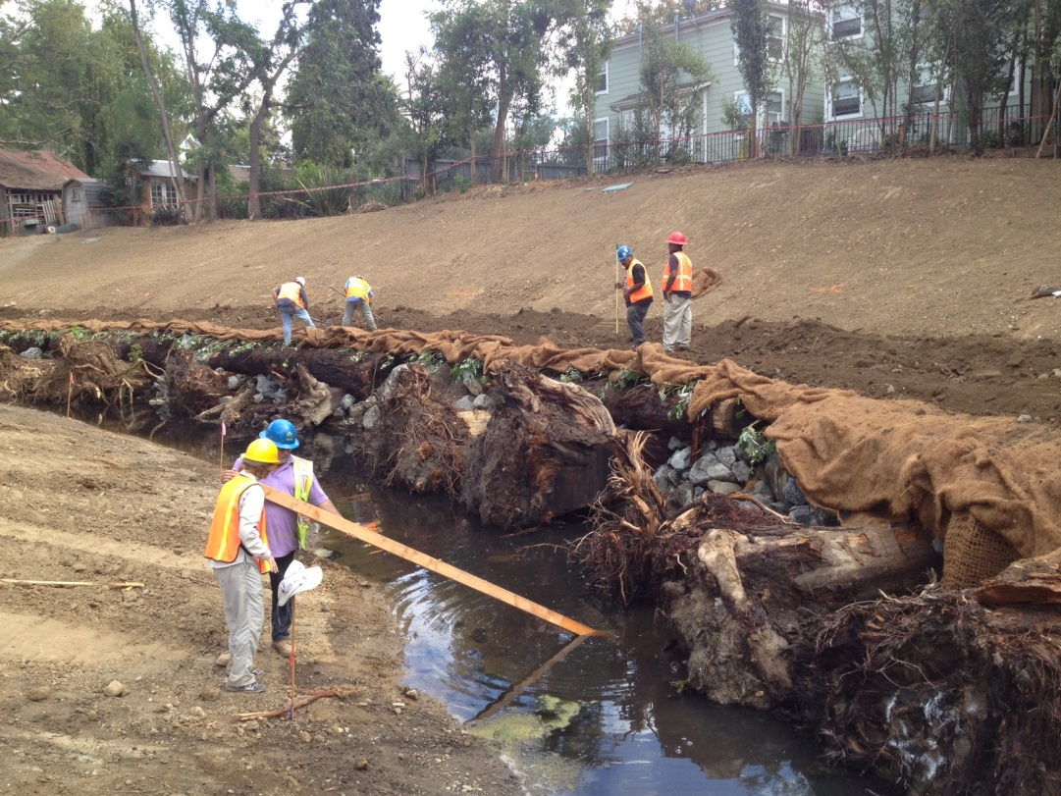
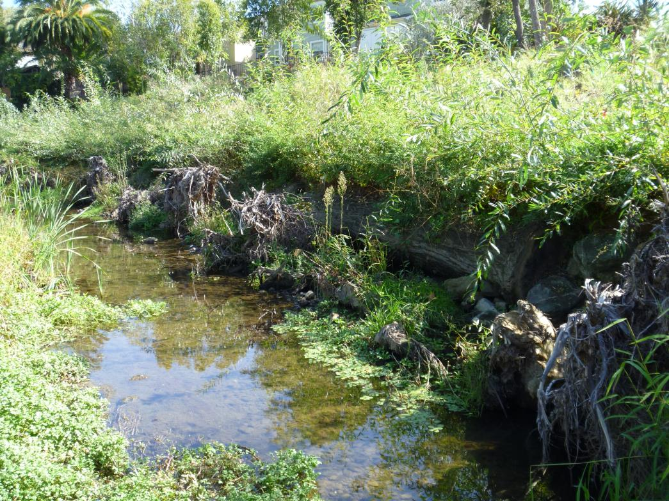
-large woody debris fish habitat structures installed in urban reach of the Project
Napa Creek - 2012
Napa Creek - 2018

Slide 13
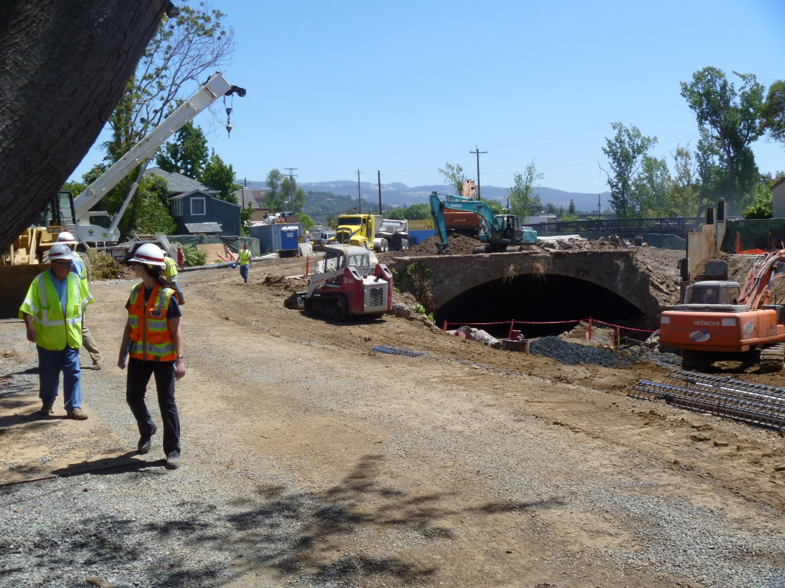
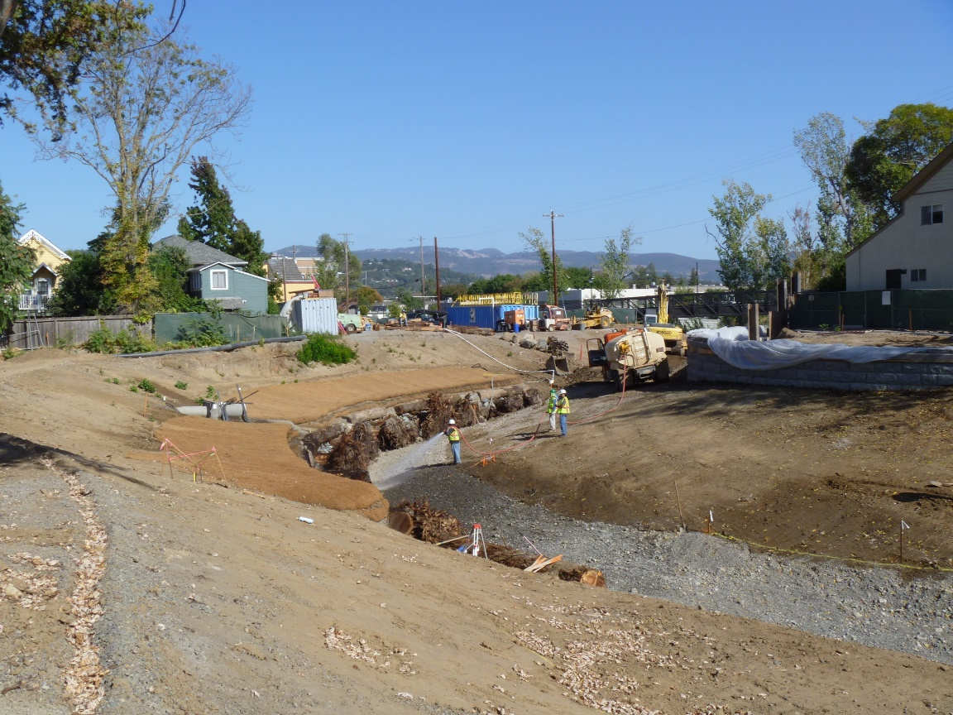
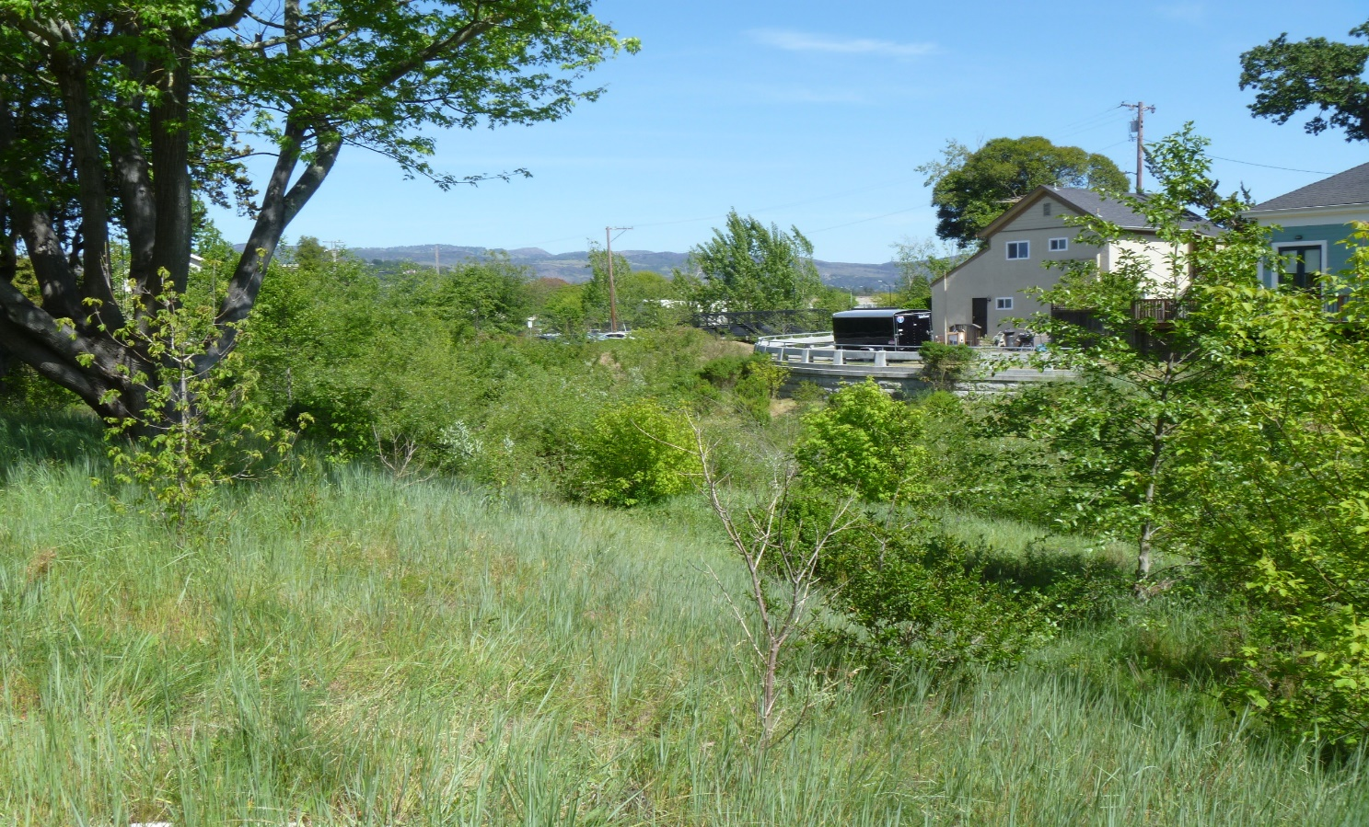
2014
Present
-150 linear feet of stream “day lighted” (bridge removed)
-Invasive plant species removed, native riparian vegetation installed

Slide 14
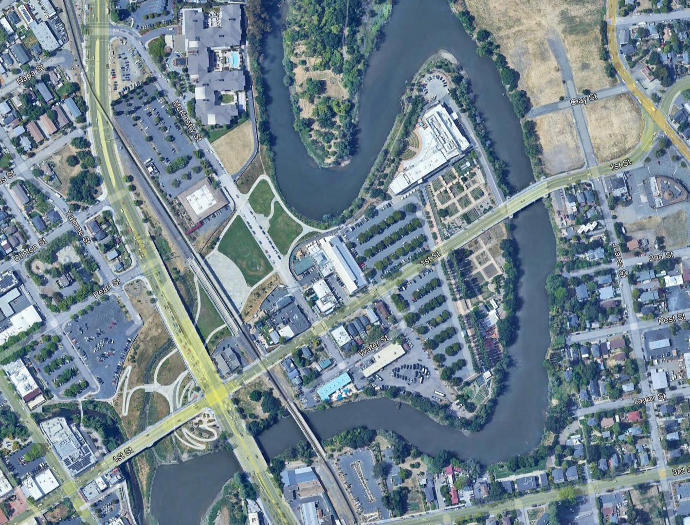
Oxbow Bypass
Napa River
Soscol Ave
Design goals of Oxbow Bypass:
-Provide 100-yr flood protection
-Provide erosion protection
-Provide public-use areas
-Habitat enhancement
-Bypass active at approx. 3-yr R.I.
Napa
Creek
First Street
Notes:
Design goals of Oxbow Bypass:
-Provide 100-yr flood protection by effectively doubling the flow capacity of the river channel through this reach and erecting floodwalls
-Provide erosion protection
-Provide public-use areas, area is managed by City Parks and Rec Department and host multiple events throw-out the year
-Habitat enhancement
-Bypass active at approx. 3-yr R.I.

Slide 15
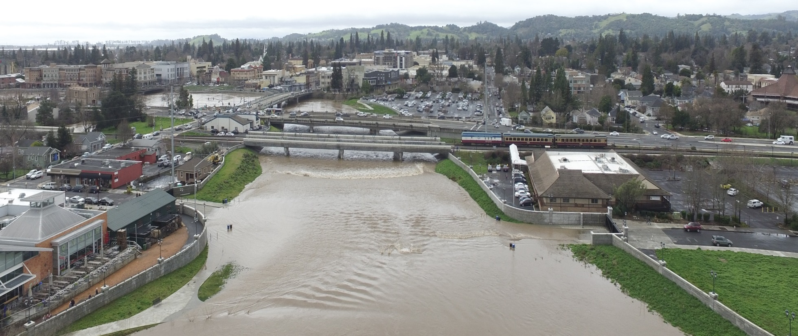
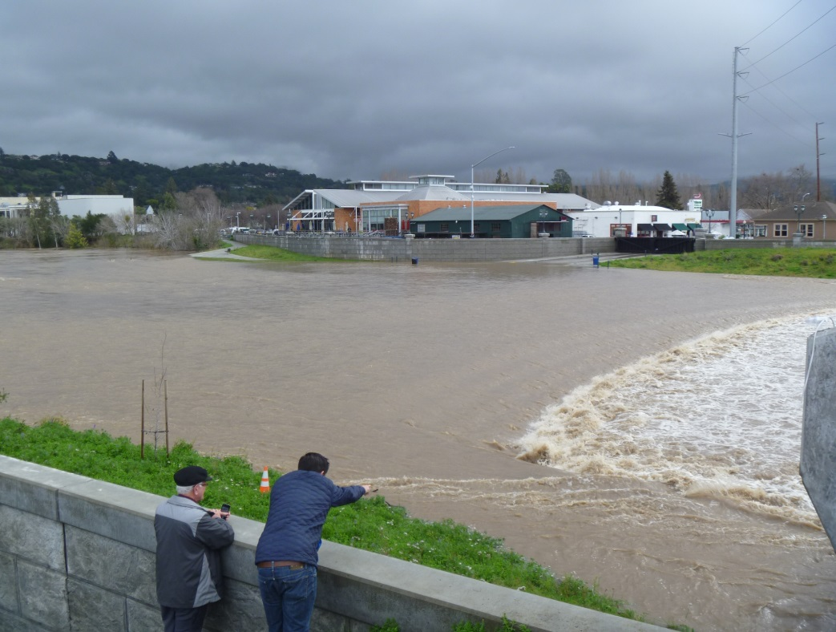
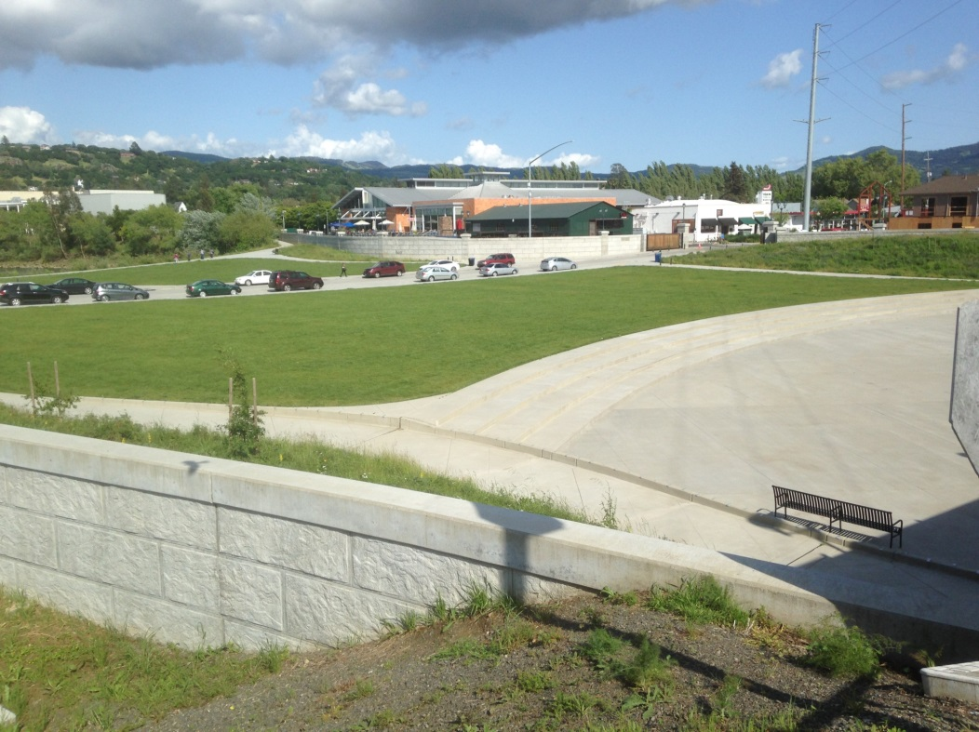
Oxbow Bypass
February 2017
April 2017

Slide 16
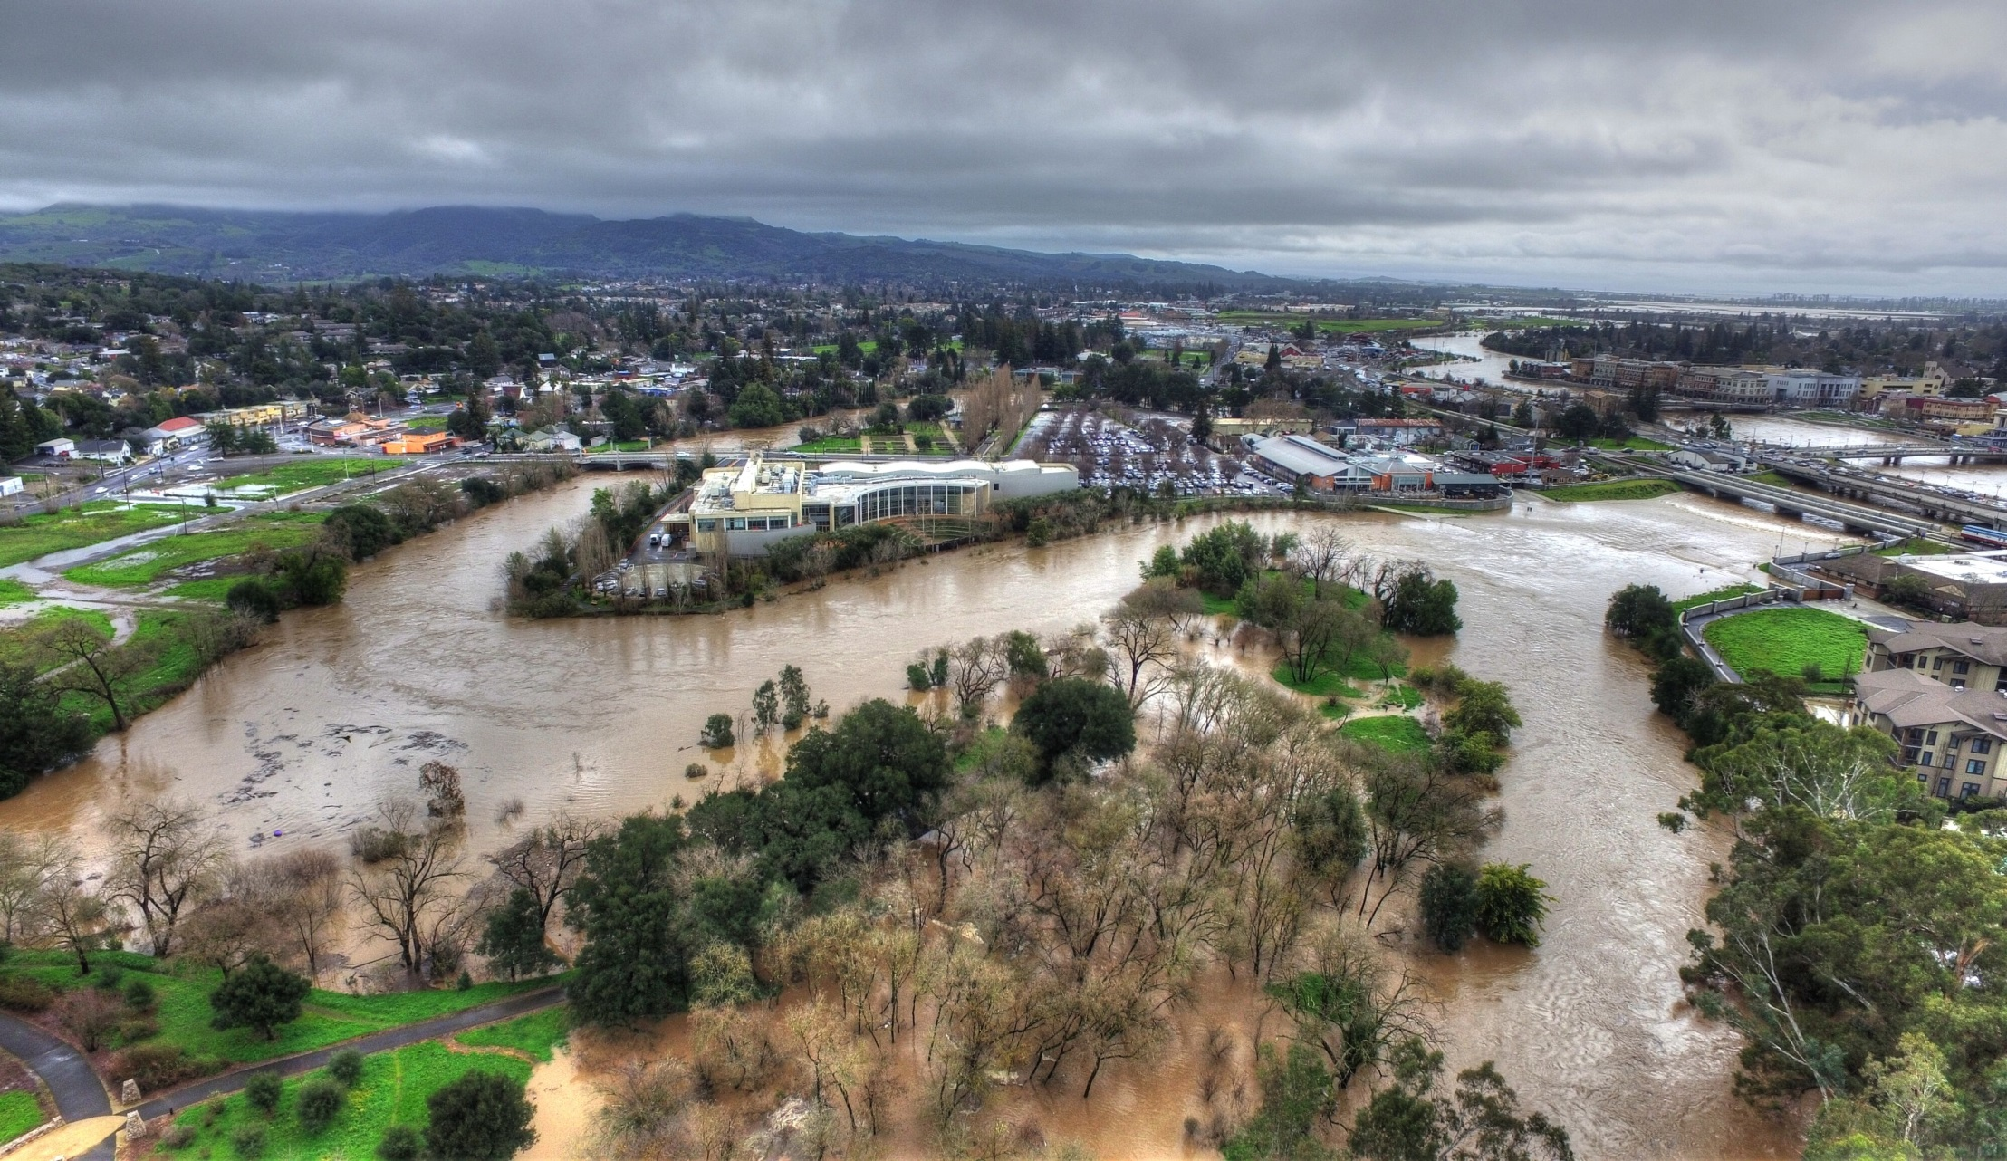
Oxbow Bypass Inlet
Looking South/Downstream

Slide 17
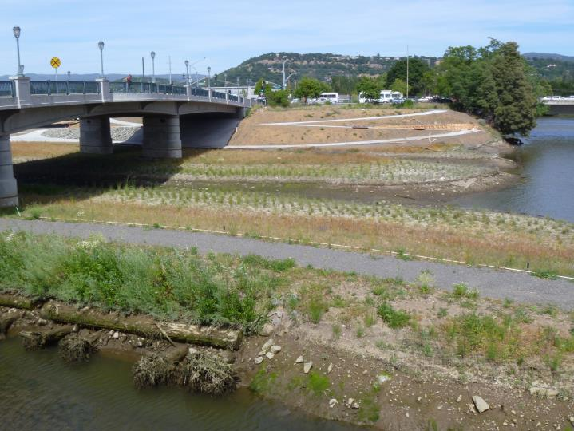
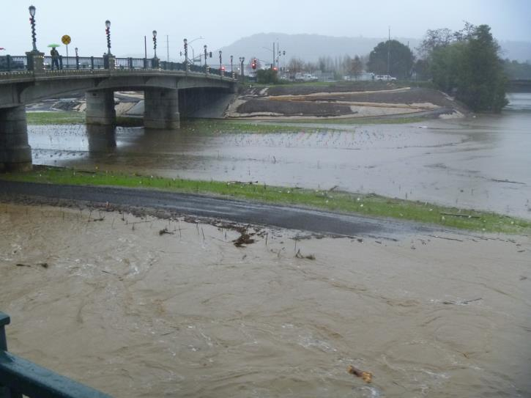
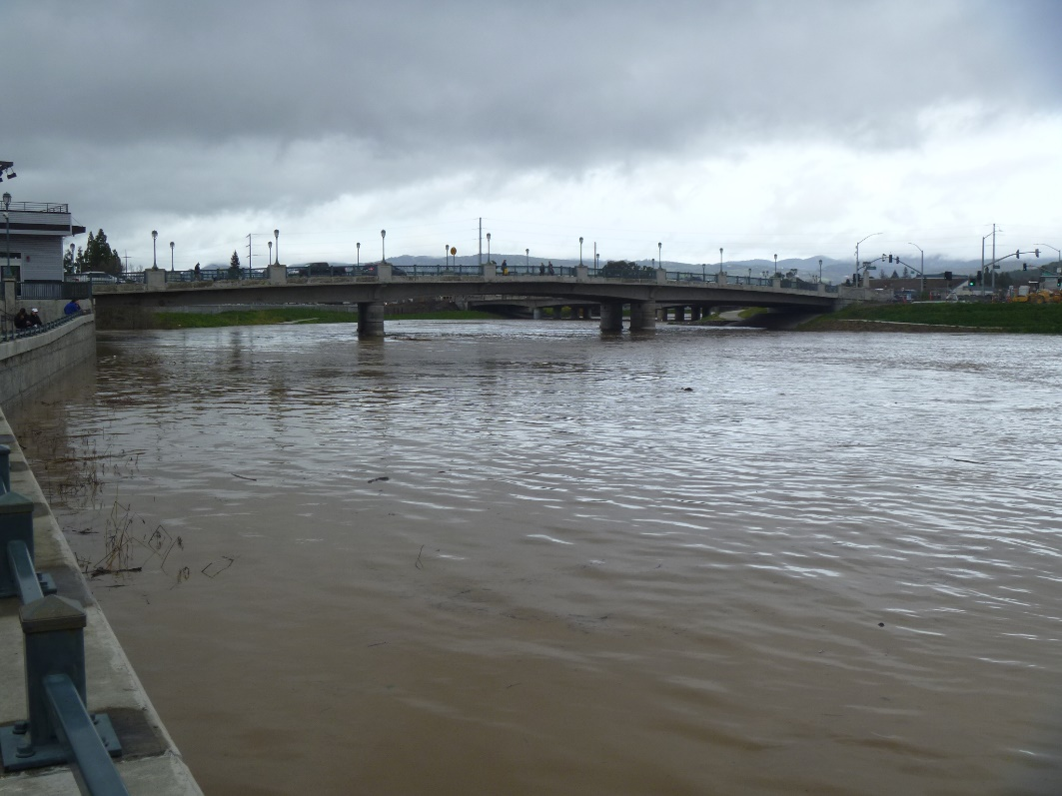
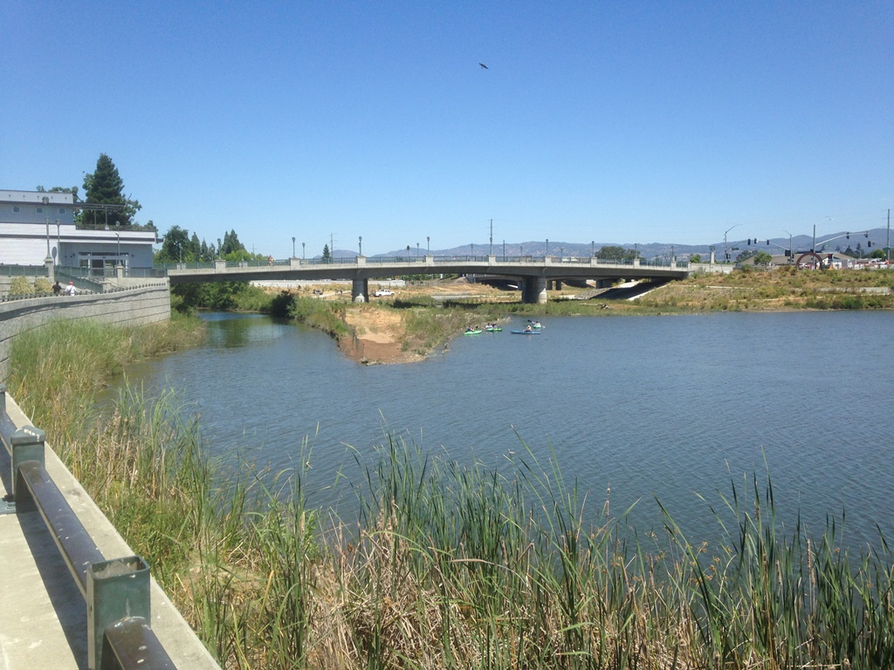
-Elevation key element to successfully establishing brackish marsh habitat, 4.5-6.5 MHW
-16 plant species installed, 14,550 total
April 2015
December 2015
February 2017
Present

Slide 18
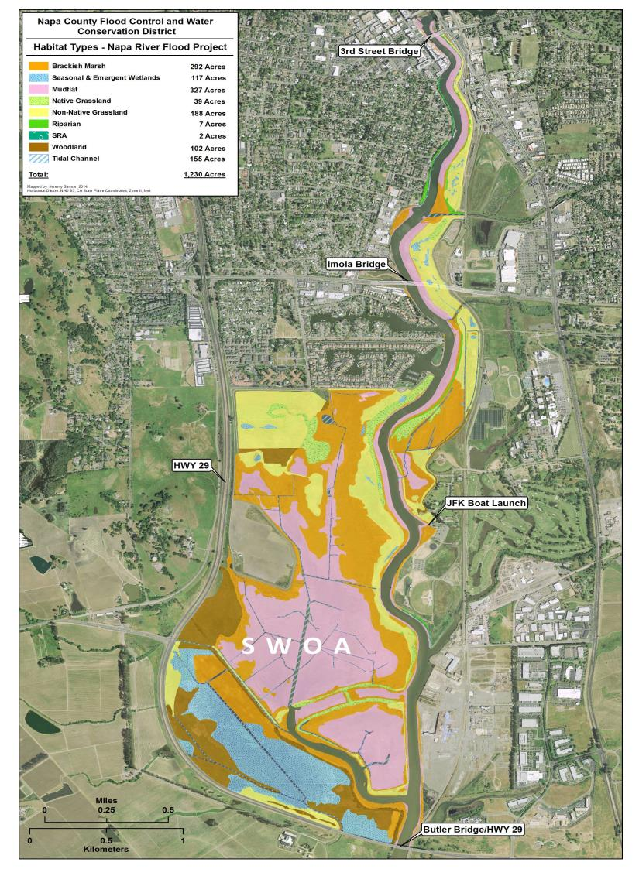
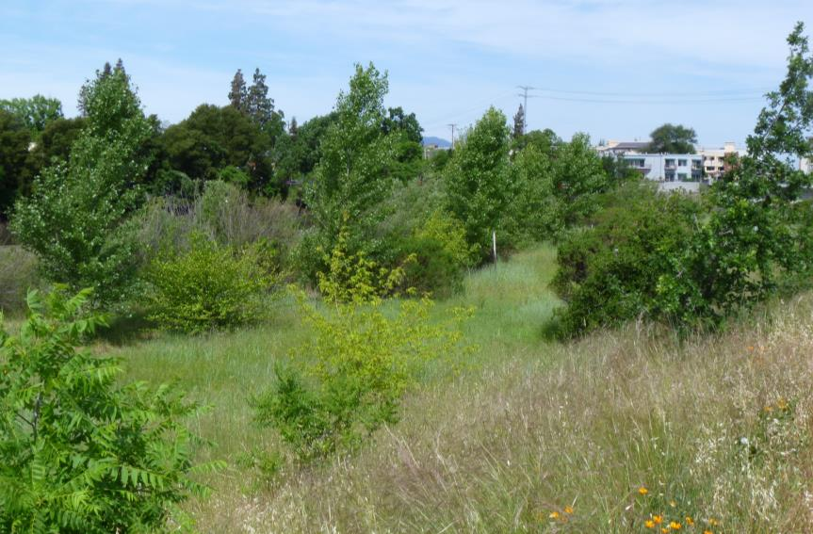
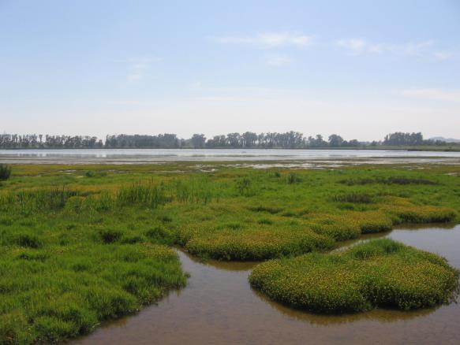
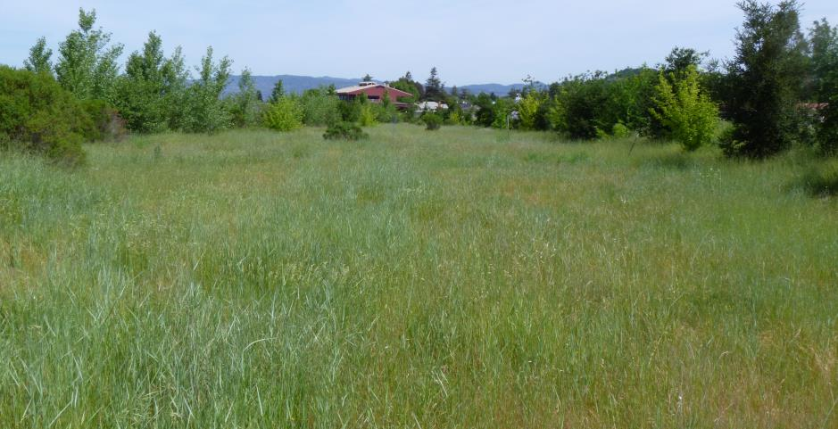
Monitoring Habitat Types in Project Area
Riparian/woodland
Native grassland
Brackish marsh

Slide 19
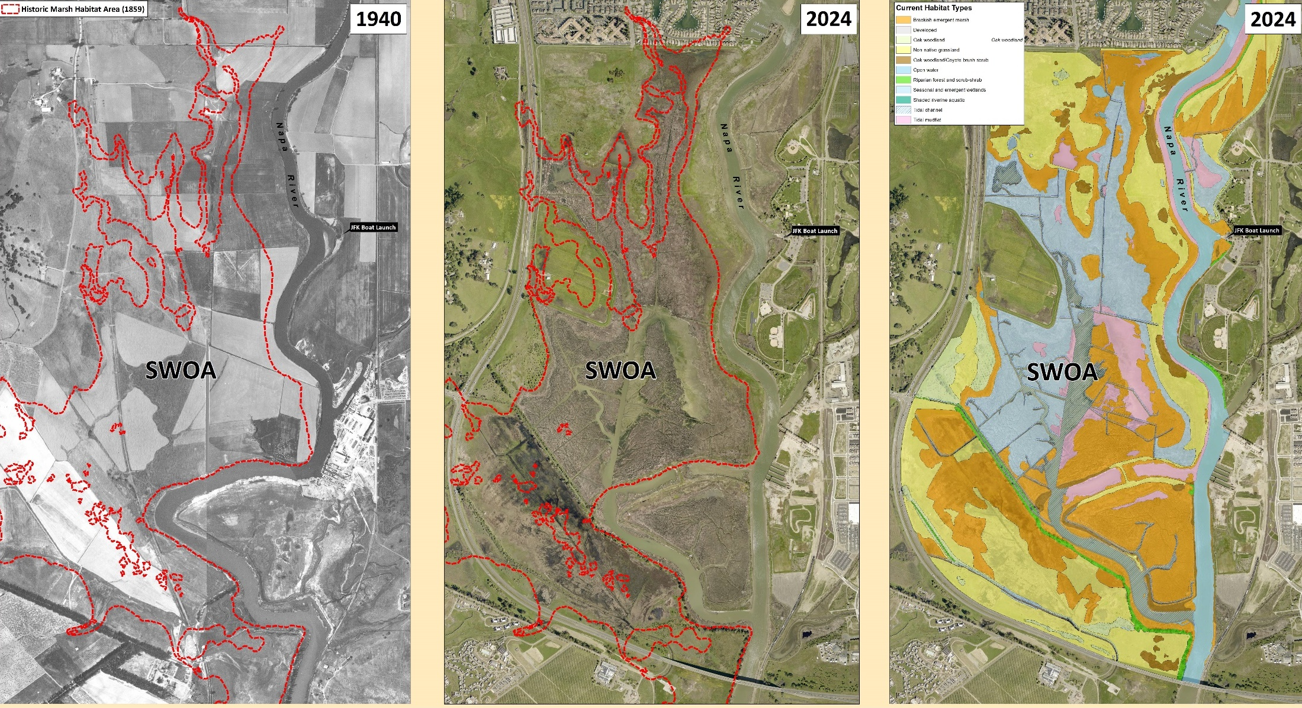
South Wetlands Opportunity Area
Restored over 75% of historic wetlands and increased channel conveyance by reconnecting flood and marshplain terraces
Created/restored over 1,200 acres of wildlife habitat
Native flora and fauna returning (birds in particular; CA Ridgway’s Rail documented)

Slide 20
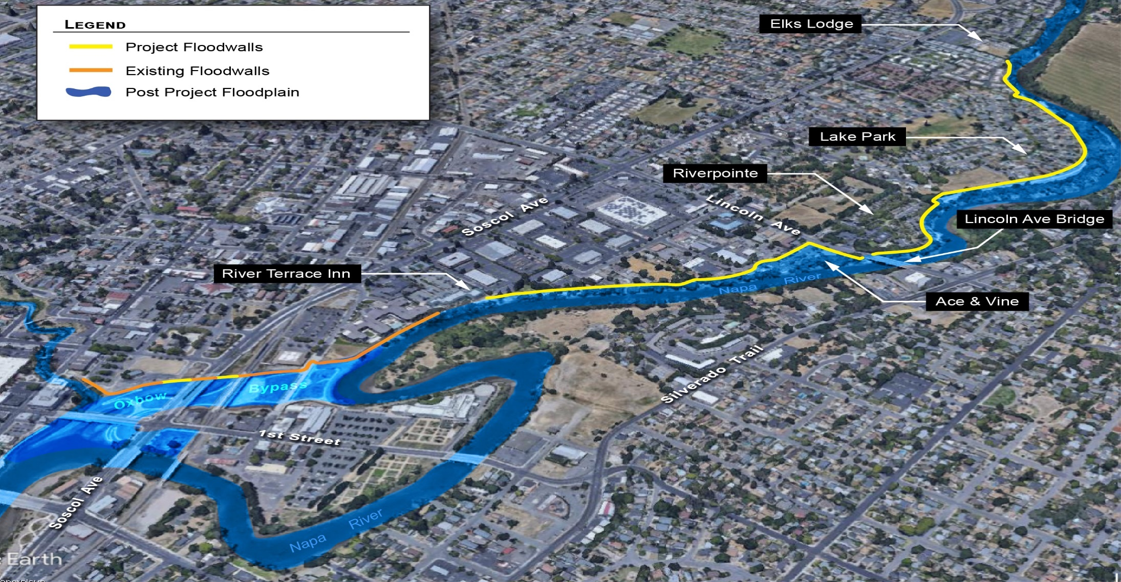
Project Update
Completion of Floodwalls North of the Bypass include:
Construction of 6,000 linear feet of floodwalls resulting in approx. 400 properties being removed from the 100-year floodplain
Building over 2,000 linear feet of new public trails

Slide 21


The Numbers
Federal share: $292.8M estimated after completion of project
State: $165M to date (subventions)
Local Share: $60M (Measure A)
Estimated reinvestment in Napa as a result of flood protection provided by Project: $2.5Billion

Slide 22

In Summary..
  Living River design principals and goals are being realized as evidence by Project monitoring
  In addition to providing 100-year flood protection the Napa River Flood Project provides multiple benefits to the community including new recreational areas and features, reinvestment in downtown Napa, restored wetlands and riverine habitat and serves as an example of a climate resilient approach to flood management

