Slide 1
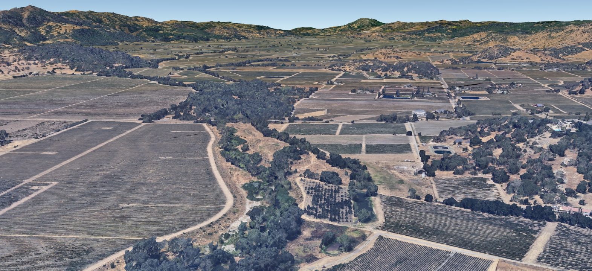

Resilient Rivers Need Room to Respond
Andy Collison, PhD Principal Scientist acollison@esassoc.com

Slide 2
Themes
How has project worked, how has it evolved?
How did it accommodate resiliency?
  Multiple levels rather than Q1.5 floodplain
  Giving rivers room
  Nodes and corridors
How permitting affects plans
Incorporate recent monitoring

Slide 3
Talking points
Why climate change creates the potential for rivers to try and widen
River corridors are narrower now than they have been historically
Case study – the Napa River Restoration Project
What can we do where river corridor widening is not an option?

Slide 4
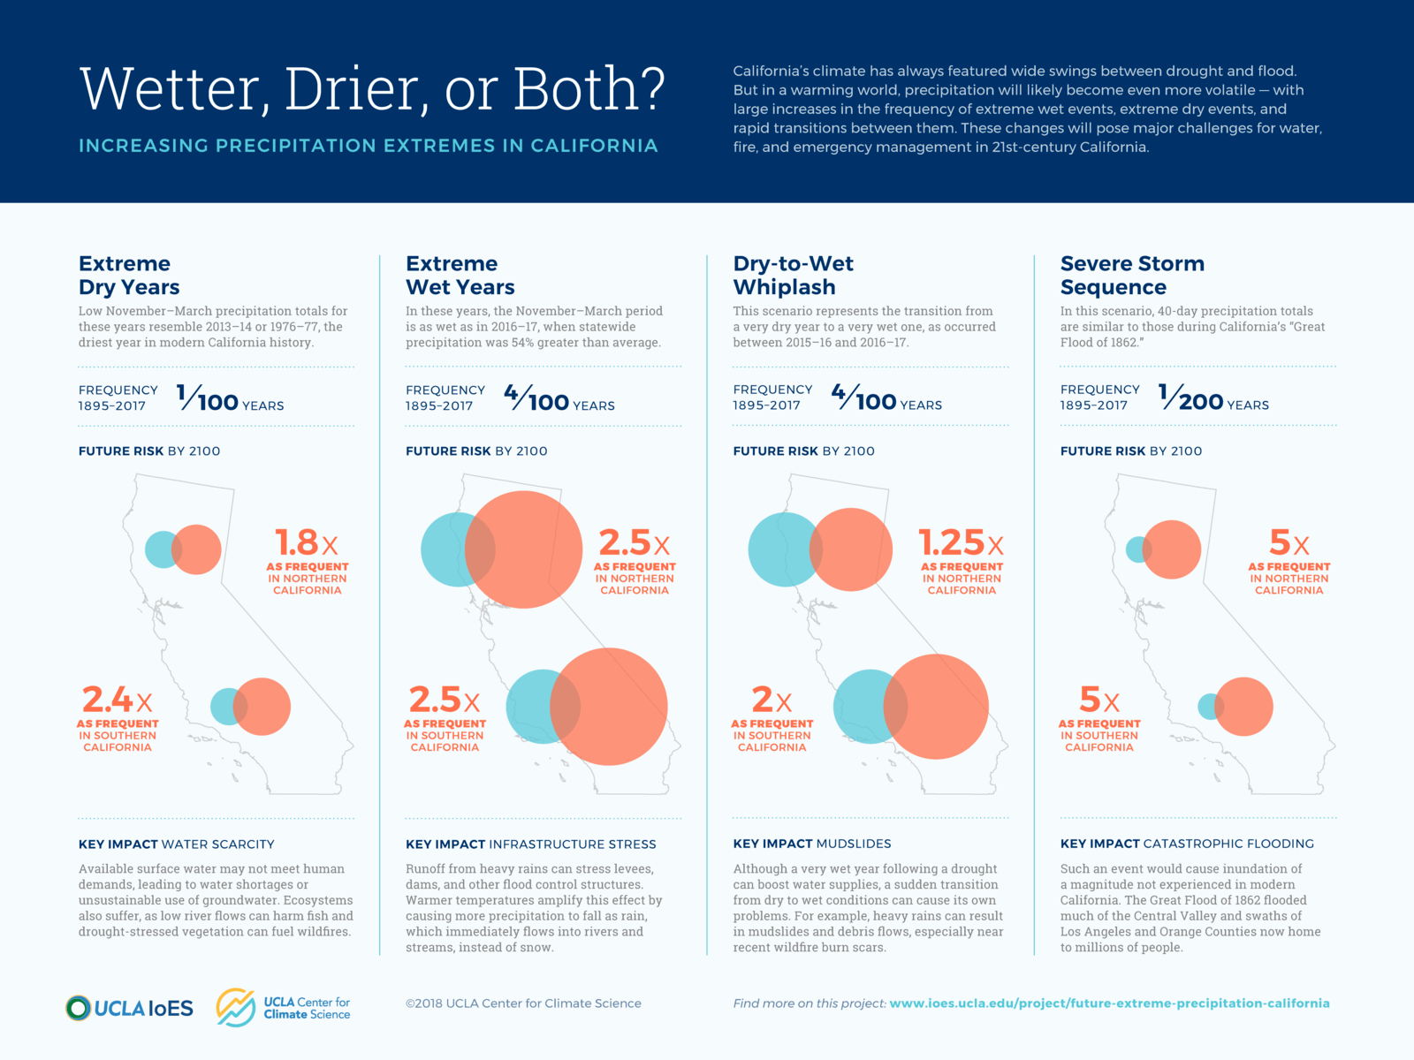
Peak flows and channel-forming flow are likely to rise in
Bay Area rivers with climate change
Number of extreme precipitation events in Napa expected to grow from ~3.3 per year to 5.4 per year under long term RCP8.5 scenario*
For Russian River watershed, climate models show typical increases of around 20% in a wide range of peak flows, including Q2 (~channel forming flow) and Q100
https://www.ioes.ucla.edu/project/future-extreme-precipitation-california/
* Napa County Regional Climate Action and Adaptation Plan,
prepared by Ascent for County of Napa, 2024

Slide 5
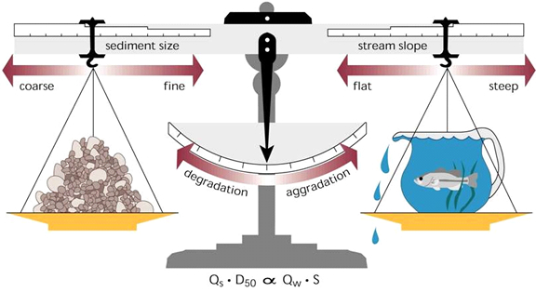
Climate change could lead to river channel widening
Flooding
Increased peak flows
Drought
Increasing fire and episodic sediment pulses
Work done side
Energy side
Likely Outcomes
Pulses of channel sedimentation with periods of channel erosion; more geomorphic dynamism and lateral erosion; potentially less flood conveyance*; more flooding.
Channel widening via bank erosion is a likely outcome.
Notes:
Accommodation space allows for more dynamic geomorphic processes and flood conveyance

Slide 6
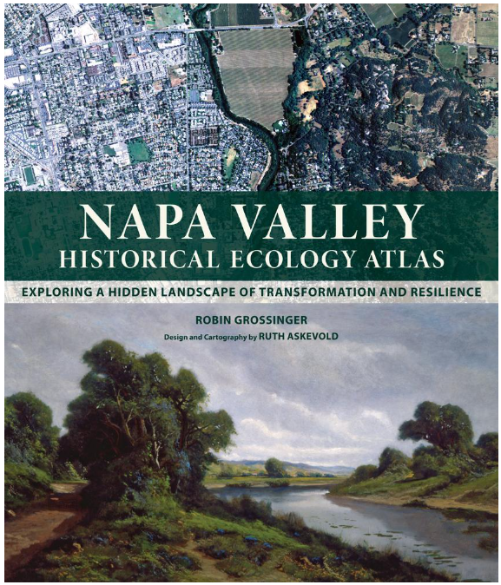
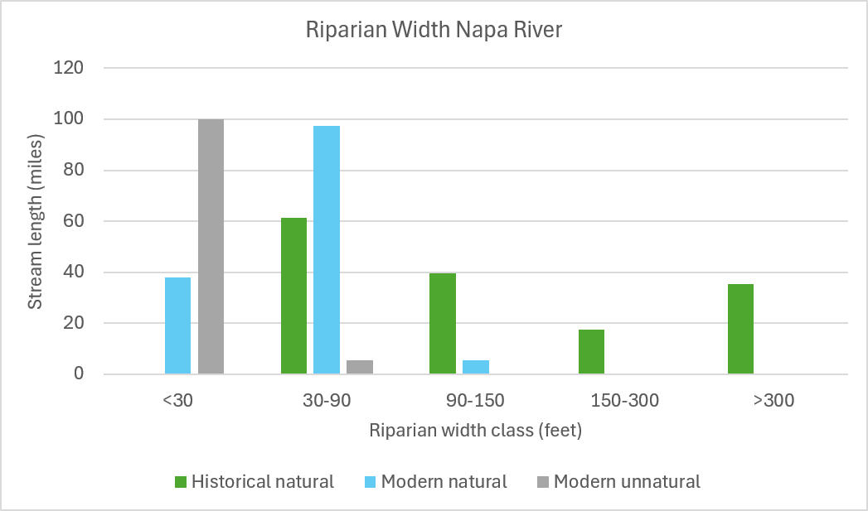
Our river corridors are narrower than in the past:
the historical case for re-widening river corridors
Creation of new ditches
Narrowing of riparian corridor

Slide 7
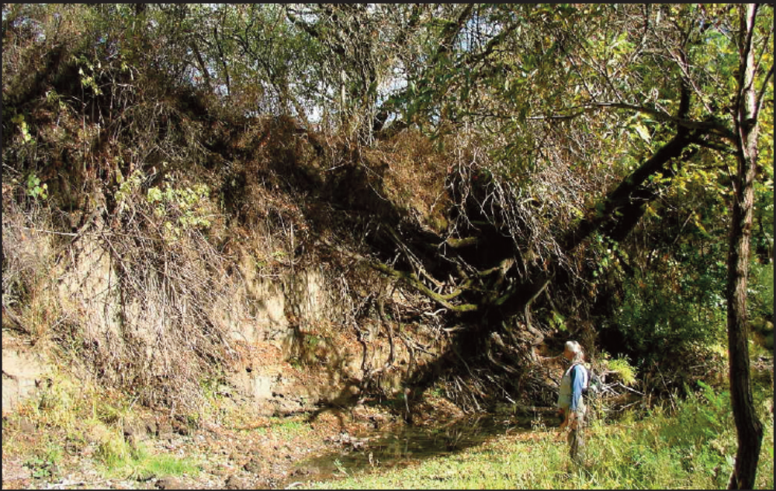
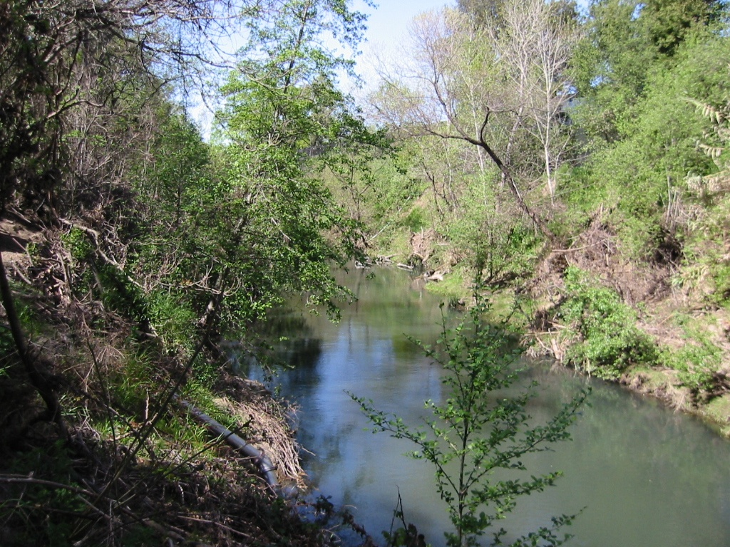
Napa River Rutherford and Oak Knoll to Oakville Projects: widening as an alternative to bank hardening
Two landowner-initiated projects
  Rutherford Project started in 2002-2015, 28 landowners, 4.5 miles of river $21M of public funds
  Oak Knoll to Oakville Project started in 2007-2022, 34 landowners, 9 miles of river
Feasibility and conceptual design by ESA, Ellie Insley and Associates, and Laurel Marcus/California Land Stewardship
After Feasibility and Conceptual Design, management of project design and permitting passed to Napa County Flood Control and Water Conservation District with ESA as the restoration design consultant
Funding from Napa County Measure A, California Coastal Conservancy, California State Water Quality Control Board, California Department of Fish and Game, the Environmental Protection Agency and California Wildlife Conservation Board

Slide 8
Napa River Rutherford and Oak Knoll to Oakville Projects: widening as an alternative to bank hardening
Two landowner-initiated projects
  Rutherford Project started in 2002-2015, 28 landowners, 4.5 miles of river $21M of public funds
  Oak Knoll to Oakville Project started in 2007-2022, 34 landowners, 9 miles of river
Feasibility and conceptual design by ESA, Ellie Insley and Associates, and Laurel Marcus/California Land Stewardship
After Feasibility and Conceptual Design, management of project design and permitting passed to Napa County Flood Control and Water Conservation District with ESA as the restoration design consultant
Funding from Napa County Measure A, California Coastal Conservancy, California State Water Quality Control Board, California Department of Fish and Game, the Environmental Protection Agency and California Wildlife Conservation Board

Slide 9
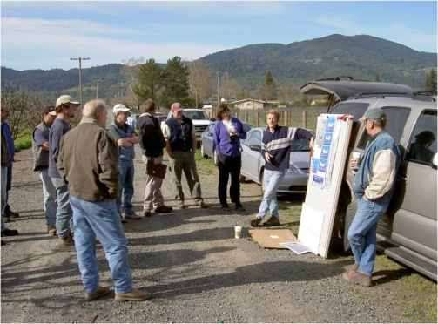
Shifting goals – from bank stabilization and restoration to corridor widening
Initial conversations focused on bank stabilization and property protection, as well as restoration and creating a legacy project
Conversations evolved to re-widening the river corridor to treat the causes of bank erosion rather than the symptoms

Slide 10
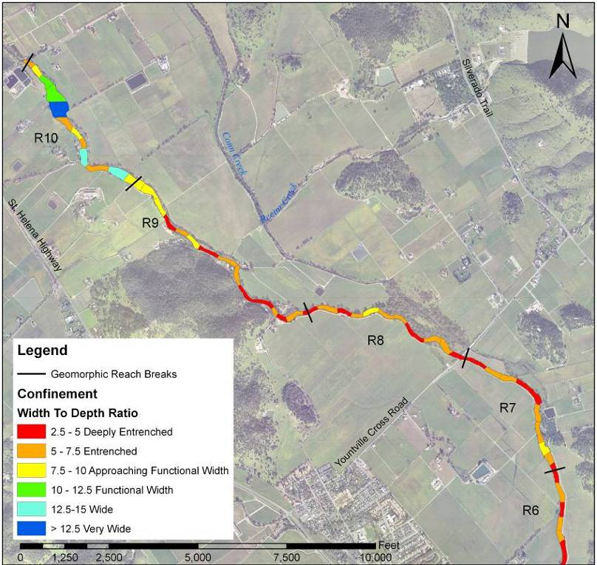
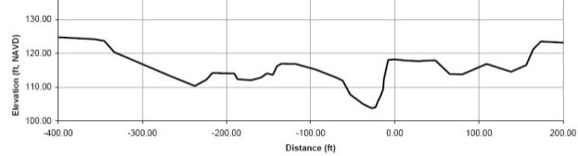
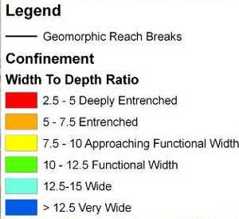
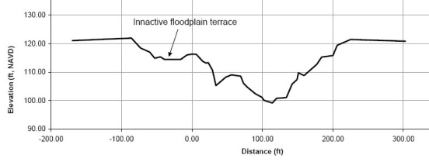
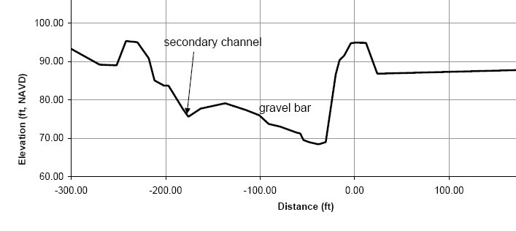
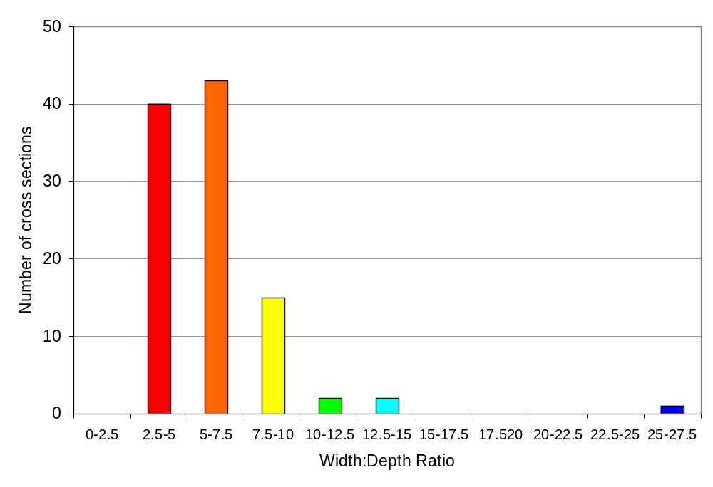
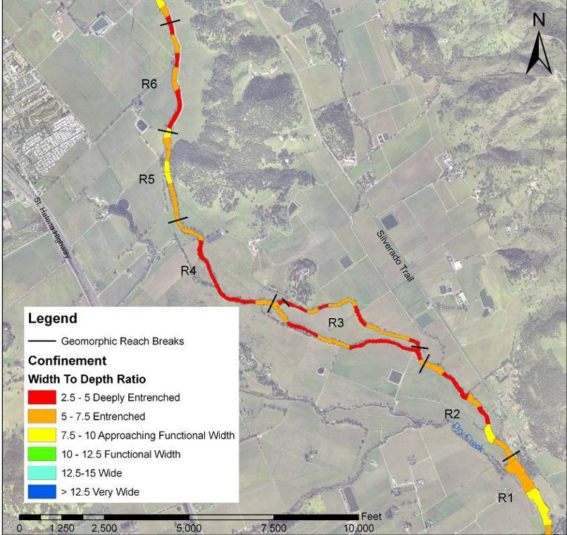
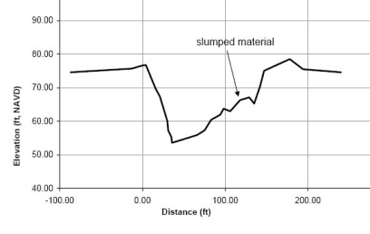
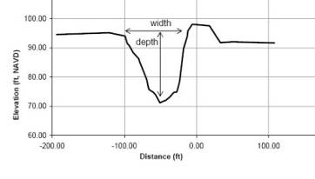
1%
2%
15%
42%
39%

Slide 11
Effects of inset floodplain widening on velocity and erosion
Floodplain width
Channel width

Slide 12
Effects of inset floodplain widening on velocity and erosion
Lessons learned:
Erosive stress and geomorphic processes that support ecological function become more likely when inset floodplains approach ~5:1 width ratio to bankfull channel.
Note this builds on very similar to work done by Liang Lee and Emily Zedler at Valley Water
Inset floodplain 10 x channel widths
Incised, no inset floodplain

Slide 13
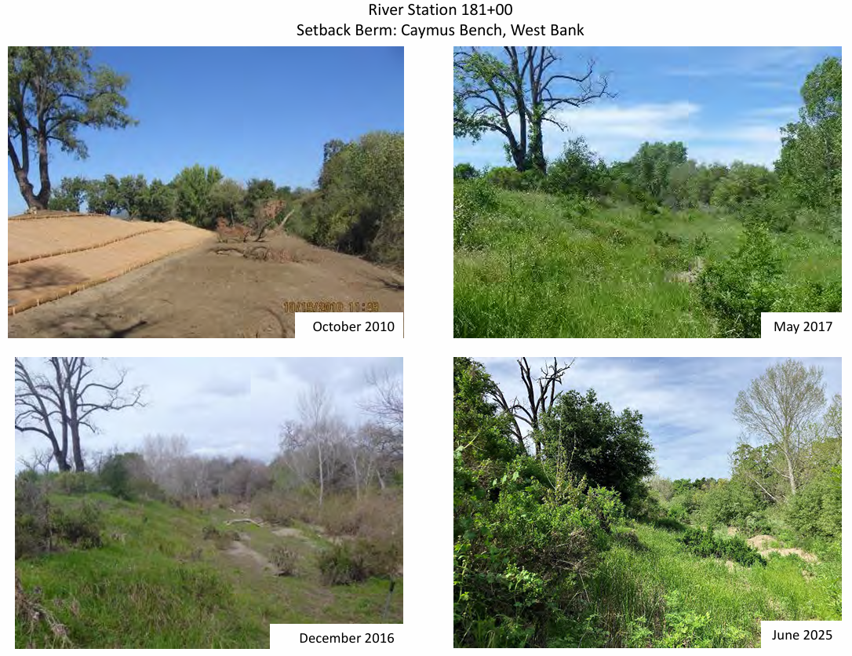
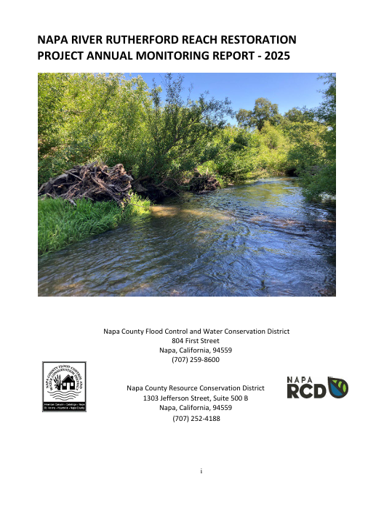
Pre-project topography

Slide 14
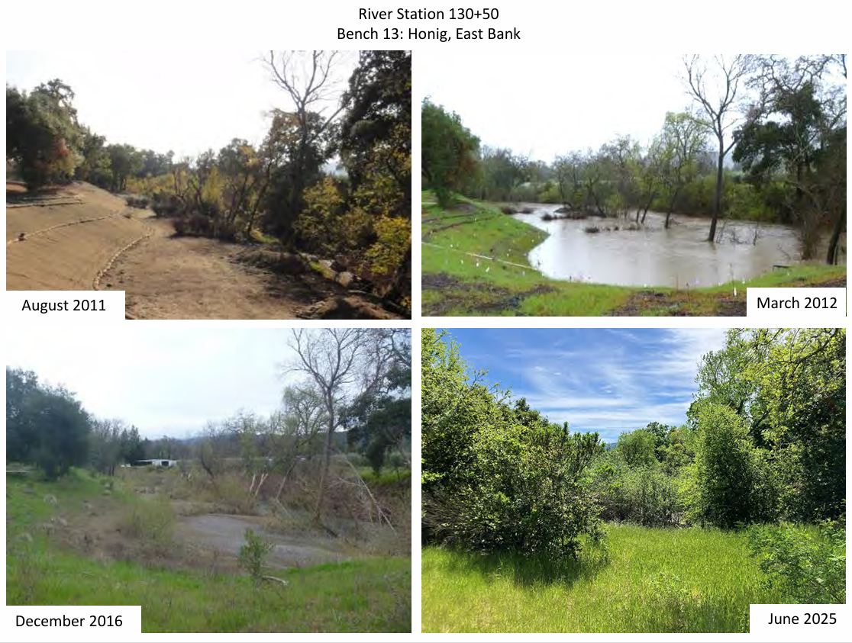
Pre-project topography

Slide 15


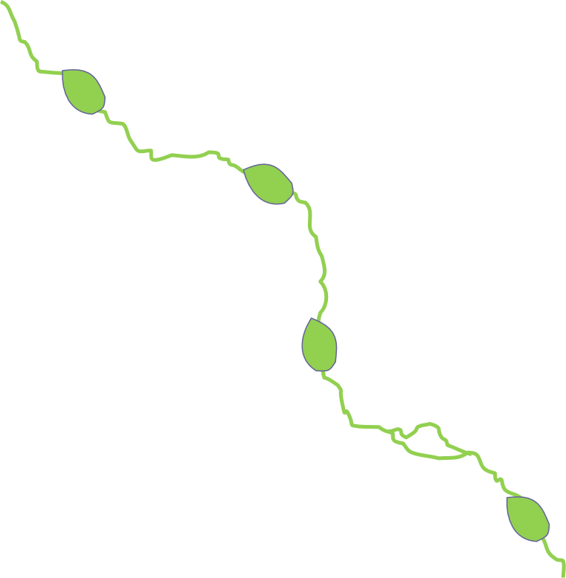
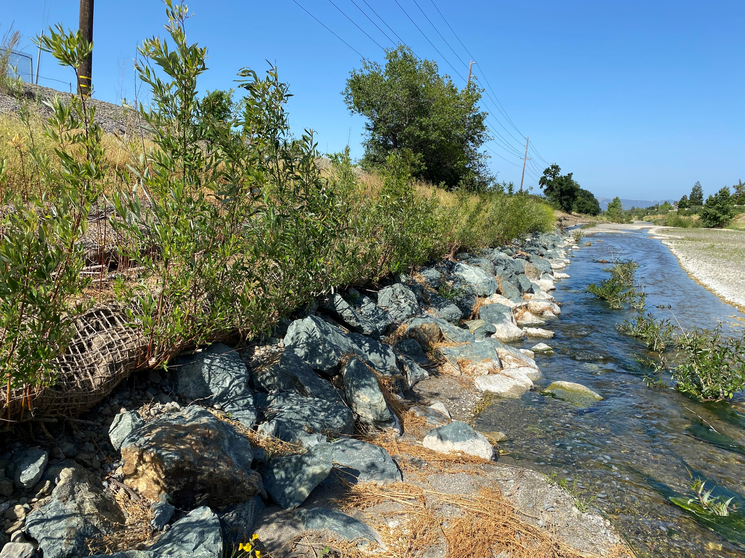
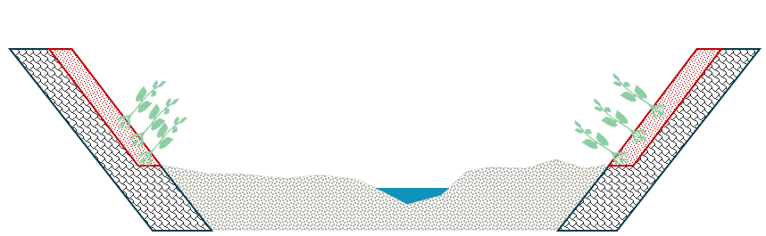
What do you do if you can’t widen a river corridor?
Existing narrow corridor
Restoration corridor – widen everywhere
Restoration nodes – widen at ecological hotspots
Restoration nodes: opportunistic widening to create islands of high functioning habitat
Providing backstops: identifying reaches where rivers can self-adjust and areas where a non-erodible backstop is needed

Slide 16
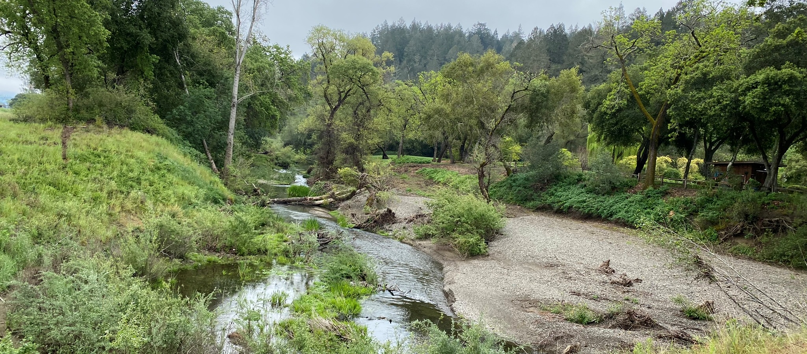
Conclusion
Climate change is likely to put more hydraulic and sediment transport stress on river corridors, which are narrower than historically
Where space permits, increasing riparian corridor width is a way to absorb increasing geomorphic dynamism and make more resilient waterways
Where space is limited, creative
solutions include creating
‘restoration nodes’ as habitat
refugia
Where this is not possible, or
between nodes, it may make
sense to create floodplain
‘backstops’ and allow channel
dynamism between these areas
Permitting challenges to identify
which approaches are appropriate
in watersheds

Slide 17
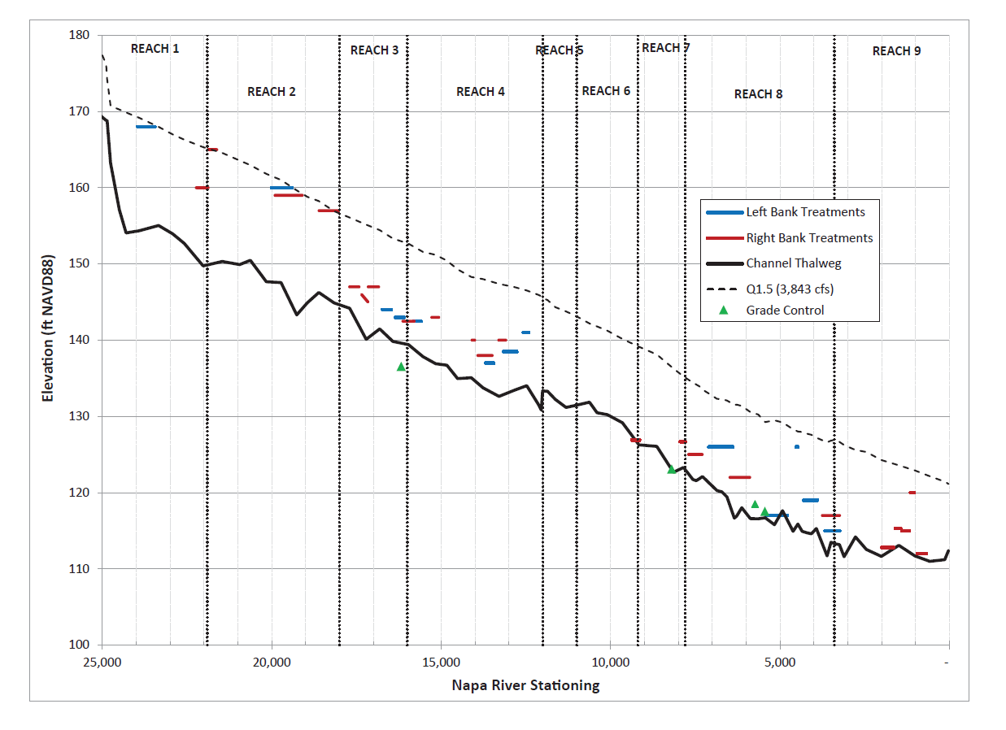
Creating floodplains
Floodplain benches at Q1.5 level in Phase 1
Floodplain benches and elevations in later phases
First project phase
1.5-year flood water level
Last project phase
Channel invert
Floodplain benches were designed to be lower as project evolved and lessons were learned

